Slide 5
Nation Expands
During the 1800s, the US gained territory in western North America. Pretty soon there was nothing left and people thought that was the end of expansion.
Russia however, offered to sell its colony of Alaska to the US. William Seward (Secretary of State) convinced Congress to buy Alaska.
Many people thought it was silly to buy it, but miners began to find gold there. Peoples’ minds began to change because it was rich in resources.

Slide 6
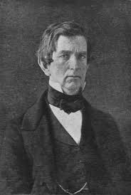
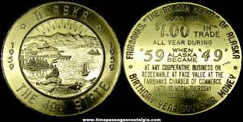
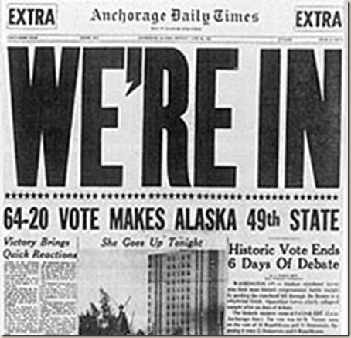
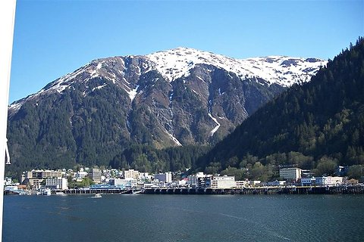
William Seward
He convinced US to buy Alaska

Slide 8
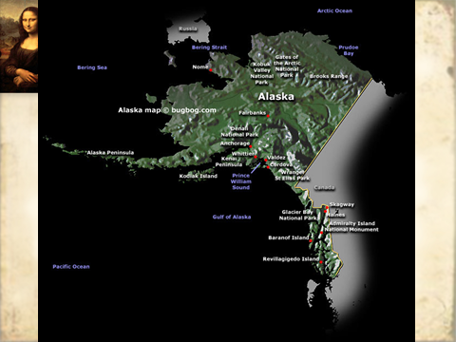

Slide 10
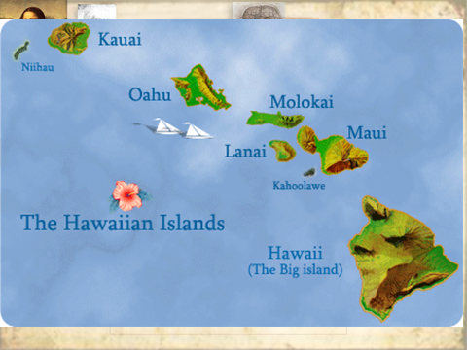

Slide 11
Spanish-American War
The US wanted to show the world it was becoming powerful when it added two new states. They wanted to build an empire by adding colonies (which means imperialism).
A conflict with Spain would add new territories.
Spain no longer had an empire and it controlled only Cuba and Puerto Rico.
The people of Cuba revolted against Spain due to its cruel rule. The stories were shocking, but not always true (yellow journalism).

Slide 12
February 1898, US Navy ship “Maine” exploded.

Slide 15
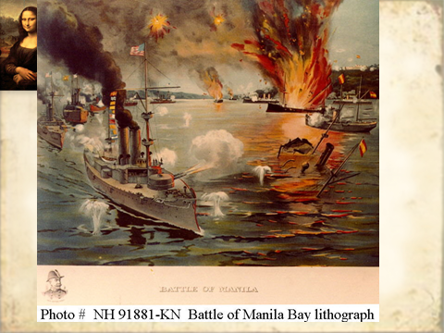

Slide 16
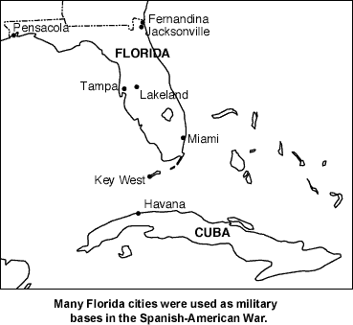
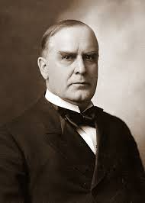
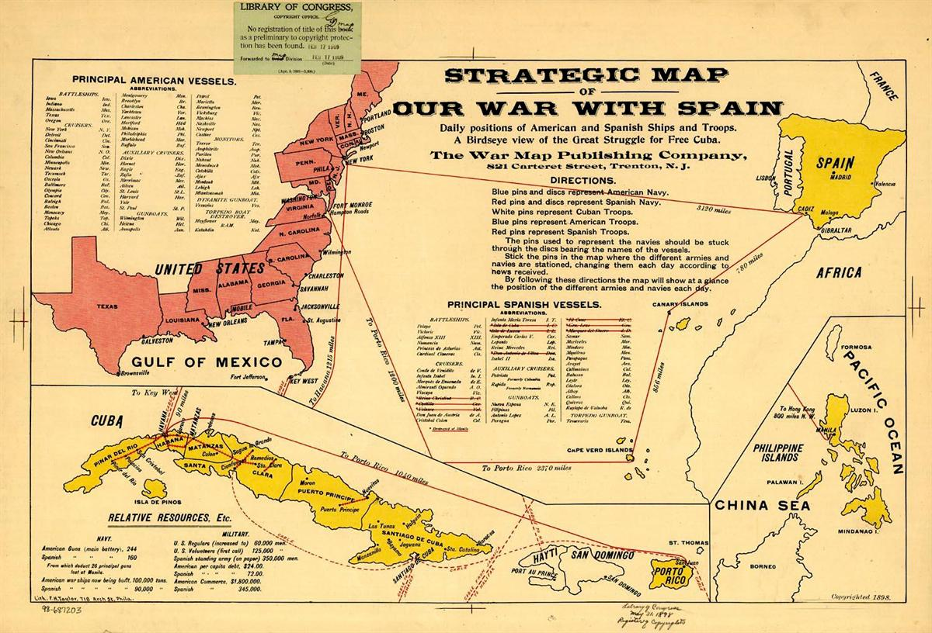
President
McKinley

Slide 17
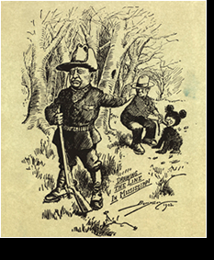
Theodore Roosevelt
He was the Assistant Secretary of the United States Navy, who supported imperialism.
He wanted to help with the fight against Spain. He quit his job and formed a fighting group called the “Buffalo Soldiers”.
Click here for a story about Teddy.

Slide 22
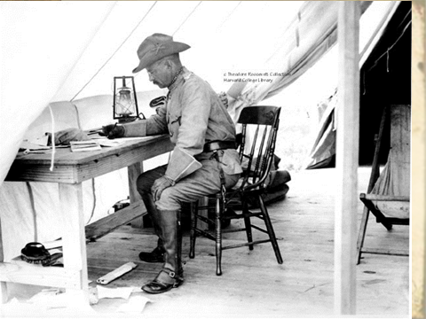

Slide 24
Panama Canal Benefits
Create a quicker journey for ships
Save money for traveling
United the east coast to the west coast
It would be built at the narrowest point in Central America, which is the isthmus (a narrow strip of land that links two larger pieces) of Panama

Slide 26
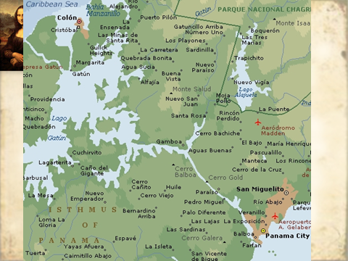

Slide 27
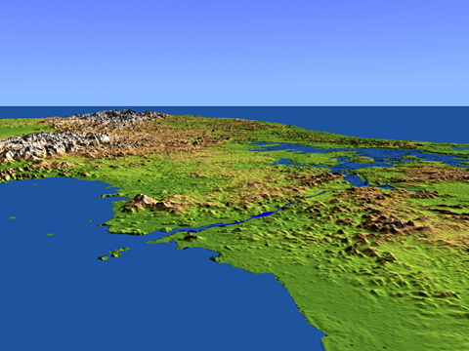

Slide 28
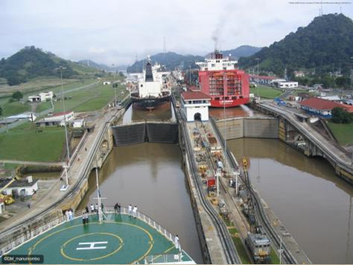

Slide 29
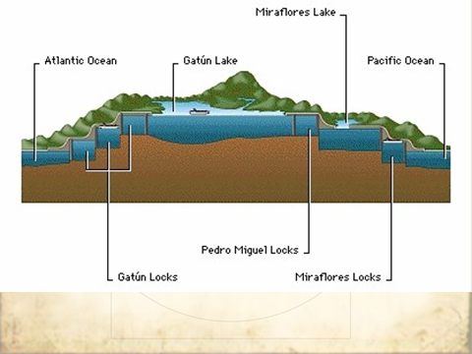

Slide 30
