Slide 1
Chapter 11 Lesson 3 “Winning the War”
EQ: What were the key military strategies and activities of WWII? What role did technology play during WWII?

Slide 2
Battles in North America and Europe
Axis Powers: JIG (Japan, Italy, Germany) were preparing for war by training soldiers and also building tanks, aircrafts, and warships.
The Axis Powers were growing stronger. Hitler (leading Germany) quickly conquered much of Europe.
Japan captured much of the Pacific region.
The US couldn’t believe how quickly the Axis Powers were taking over.

Slide 3
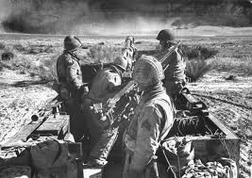
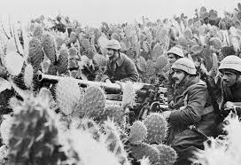
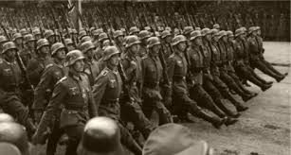

Slide 4
Battles in North America and Europe
In 1942, the Allies began to move against the Axis. Americans joined the Allies in North America. They were fighting German and Italian forces.
For many months, they even fought Germans in tank battles on the hot sands of the Sahara Desert.

Slide 5
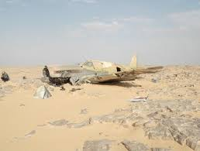
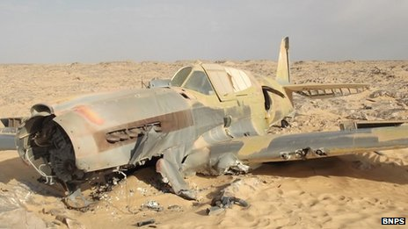

Slide 6
Fighting in Italy
The Allies struck Italians on the island of Sicily (Italy) in 1943 and continued to invade Italy’s mainland. The Germans began to retreat. Many were wounded.
A group of African Americans known as the Tuskegee Airmen, flew many successful missions over Italy.

Slide 7
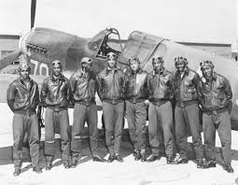
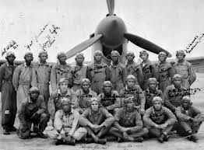

Slide 8
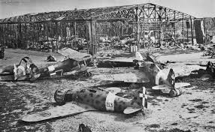
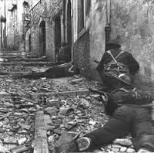
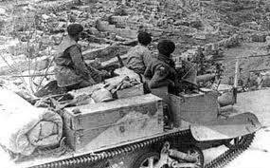

Slide 9
D-Day and Victory
The next big blow came on June 6, 1944 known as D-Day. D-day stood for the day or date of a planned military operation.
On this day, about 200,000 Allied soldiers invaded northern France.
Many soldiers died in the fighting, however 1 million soldiers landed in France and this allowed the Allies to begin to move toward Germany.

Slide 10
More Victories
Soviet soldiers were also advancing in Germany from the east. In May 1945, Germany was forced to surrender.
The Allies declared May 8 Victory in Europe Day, or V-E Day.

Slide 11
Fighting in the Pacific
Even though fighting in Europe had ended, it didn’t mean WWII was over. The Allies also had to face Japan.
Japan had won many battles after the attack on Pearl Harbor and controlled much of the western and eastern portion of Asia.
Allies had a major victory over Japan called the Battle of Midway (lead by Chester Nimitz).

Slide 12
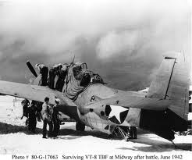
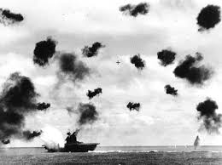
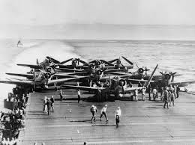
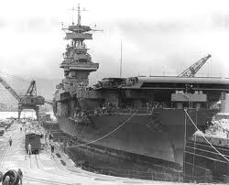

Slide 13
Fighting in the Pacific
The battle was won using US aircraft carriers. An aircraft is a large ship that carries airplanes far from land. Planes are able to take off from the carrier.
At the Battle of Midway, US planes sank four Japanese aircraft carriers.
This victory gave America more power.

Slide 14
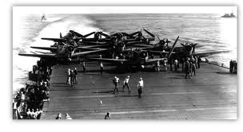
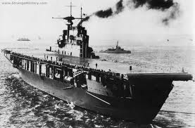
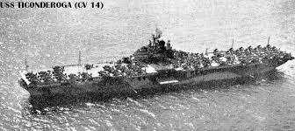
Aircraft Carriers

Slide 15
Island Hopping
In order to defeat Japan, we used a tactic called “Island Hopping”. This allowed Allies to skip over islands guarded by Japanese and capture others. Each island the Allies took over put us closer to Japan.
This took place for 3 years. We were able to capture New Guinea, Iwo Jima, and many other islands.

Slide 16
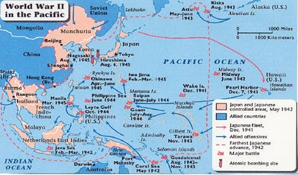

Slide 17
Navajo Code Talkers
We used Navajo Indians who had joined the US Marines to create a secret code that the Japanese couldn’t understand.
The code talkers sent important messages and orders between Allies leaders and soldiers.

Slide 18
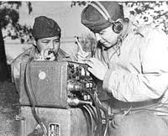
Navajo Code Talkers

Slide 19
Victory over Japan
In 1945, we were close enough to Japan to invade the nation. President Truman didn’t want many US people to die so he had a plan.
The US had developed a secret weapon called the atomic bomb that could destroy an entire city.
On August 6, 1945 Truman ordered to drop the bomb on Hiroshima, Japan.

Slide 20
Victory over Japan (VJ DAY)
The explosion killed 100,000 people.
Three days later, the US dropped an additional atomic bomb on Nagasaki, another Japanese city.
The emperor, Hirohito soon surrendered on August 14, 1945 and this day was known as VJ Day (victory over Japan).

Slide 21
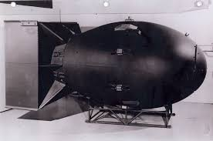
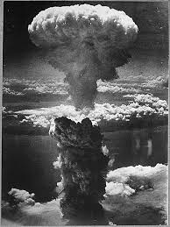
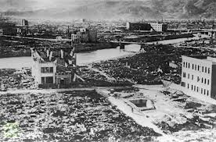

Slide 22
Changed World
People were very happy the war was over, however we had to face how much destruction was caused.
Many people were killed in the war and some cities lay in ruins.
European civilians had no homes, no food, and no jobs.

Slide 23
Holocaust
As the fighting ended, Allied discovered a terrible horror of the war.
In Europe, the Nazis had killed millions of people in concentration camps. This is where large numbers of people were held as prisoners and forced to work. At the camps, men, women, and children were beaten, starved, and killed.

Slide 24
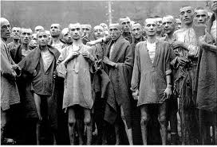
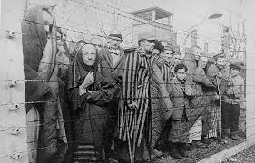
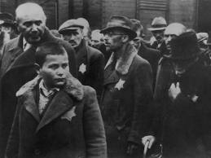
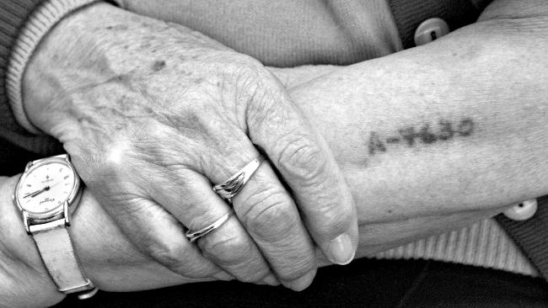

Slide 25
Holocaust
Many of the people that were killed were Jews, these were the people Hitler blamed for Germany’s problems.
German soldiers killed twelve million people, six million of them were Jews. This mass destruction was known as the Holocaust.

