Slide 1
Chapter 2: Landforms of Georgia Lesson 4: How Do Humans Change Landforms?
S5E1c: Students will relate the role of technology and human intervention in the control of constructive and destructive processes.

Slide 2
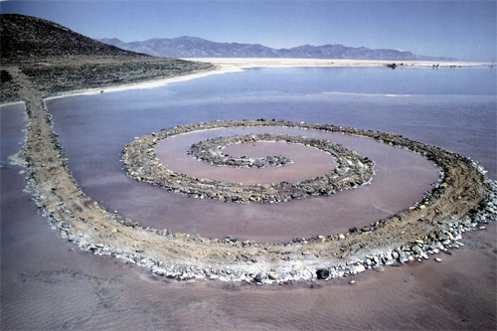
Vocabulary Preview
Jetty: a wall-like structure that sticks out into the ocean

Slide 3
Seismological Studies
Early on April 29, 2003, the ground shook under Atlanta (windows rattled, dishes fell).
An earthquake had struck Northern Georgia.
Earthquakes do happen in Georgia, but are rare.
Earthquakes usually happen along fault lines, or at the edges of plates.
Earthquakes can be constructive, like forming mountains or lakes.

Slide 4
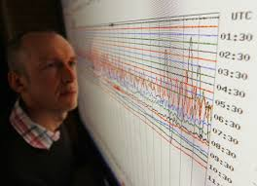
Seismological Studies
Most earthquakes are deconstructive.
Roads and bridges are damaged, and buildings fall down. Scientists work hard to prevent natural disasters.
Seismologist is a scientist who studies earthquakes. They use many tools to monitor Earth’s crust movement.

Slide 5
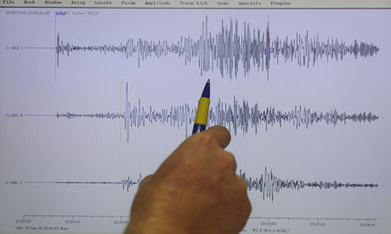
Seismological Studies
These tools include: seismographs (records movement in Earth’s crust).
It helps scientists learn how strong the quake was, when did it happen, how long did it last.
When they receive this information, they can use the data from the seismograph to locate the quake’s epicenter.

Slide 6
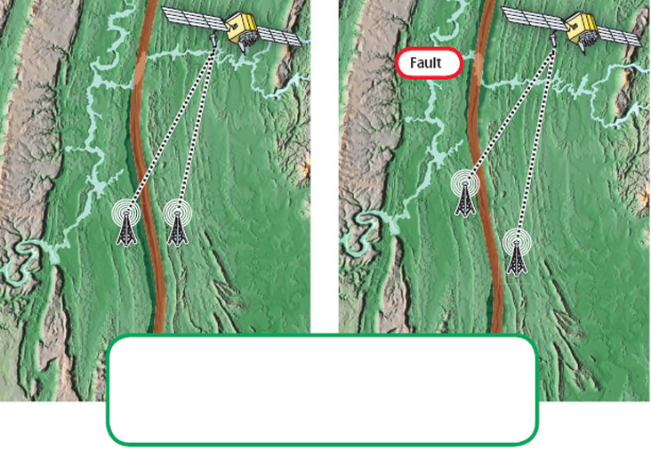
GPS, or Global Positioning System, is a network of 24 satellites. It works with receivers on the ground to determine exact positions on Earth’s surface. Seismologists use the data to measure the movement of faults. Look at the two images. With GPS, scientists can determine how the land has changed.

Slide 7
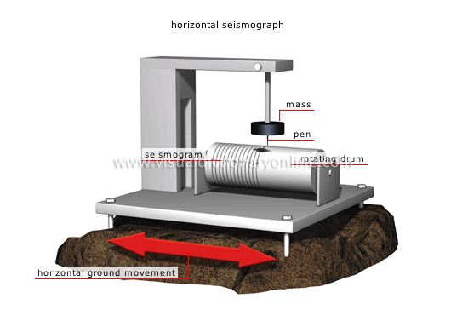
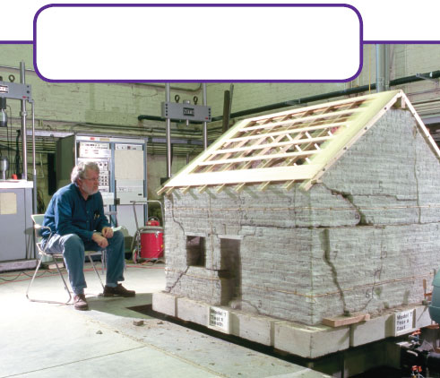
A shake table simulates the ground movements during an earthquake. These experiments help identify materials and types of construction that are most resistant to cracking and collapse when they are shaken.

Slide 8
Seismological Studies
Seismograph data helps scientists draw seismic hazard maps.
These maps identify areas most likely to shake when rocks shift at faults.
If they are moving towards cities, officials can notify the public so they can prepare.

Slide 9
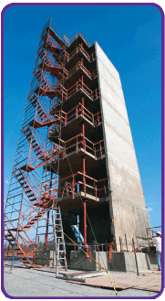
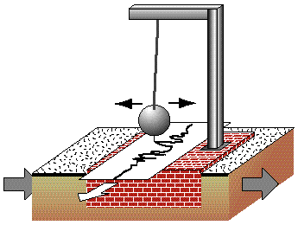

Slide 10
Flood Control
Floods are a natural process. They can occur anywhere near a body of water.
Floods too, can be constructive (ex. Some plants that grow along the shores of rivers and lakes adapted to grow best in flooding conditions).
Erosion along the banks of rivers can cut channels into rivers, carve out shallow areas for animals to drink, and for new aquatic life to hide.

Slide 11
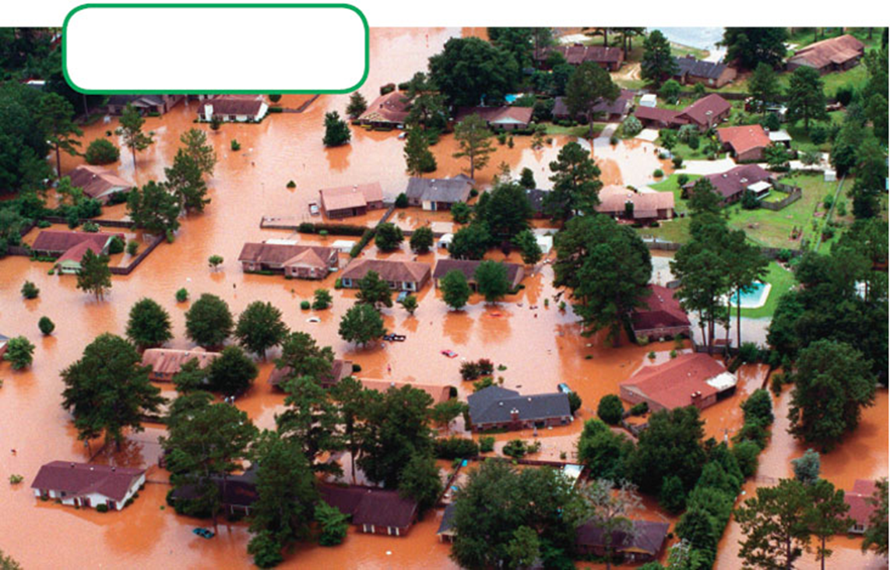
Flood Control
Floods are usually not good for people. They are usually destructive and costly. Floods have cost farmers entire fields of crops. Flood damages houses, farms, and towns. As cities expand, flood damage increases.
After Hurricane Alberto, in July 1994, the Flint River overflowed and flooded much of Albany, Georgia.

Slide 12
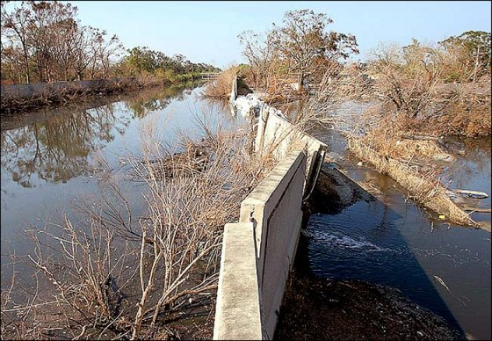
Flood Control
Building dams and levees are two methods of controlling floods.
A levee is a wall of earth or concrete built along the banks of a waterway.
It keeps rising flood within channels.
Dams hold back water that rushes downstream.
By building dams, we change the natural flow of Earth’s water.
Also, the dam stops the flow of a river, forming a lake.

Slide 13
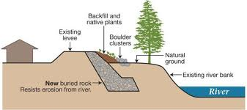
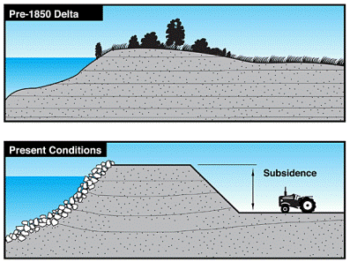
Levees

Slide 14
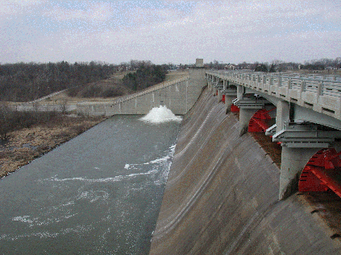
Flood Control
Most flood control methods work.
They prevent flood waters from damaging the land as they normally would.
Sometimes these methods have drawbacks.
Dams and levees stop the flow of sediment the water carries.
They prevent deposition of sediment along deltas.

Slide 15
Flood Control
In some places, people have turned to another method of flood control.
They remove any structures built on floodplains, so when rains are heavy, streams spill over onto the floodplains.
There soil and wetland plants absorb the excess water.
When the flood waters recede, there are no damaged structures left behind.

Slide 16
Beach Restoration
Erosion is another natural process that shapes land.
Waves erode sand from Georgia’s shores each day.
Sand is eroded by waves and deposited at other places along the shore of the ocean.
Currents also cause beach erosion.
Longshore currents that carry swimmers along the beach also carry sand.
Eroded sand is then deposited at other places where the current slows.
Often, it is deposited at the mouth of a river.

Slide 17
Beach Restoration
The erosion and deposition of sand causes two problems.
One: sand moves away from some beaches and builds up others.
Two: moving sand fills in channels, which then become too shallow for boats to pass through.
Cumberland Island, near FL/GA, has sand dunes that protect the land from storm.
But the erosion of the dunes, puts GA’s coast at risk and fills ship channels.

Slide 18
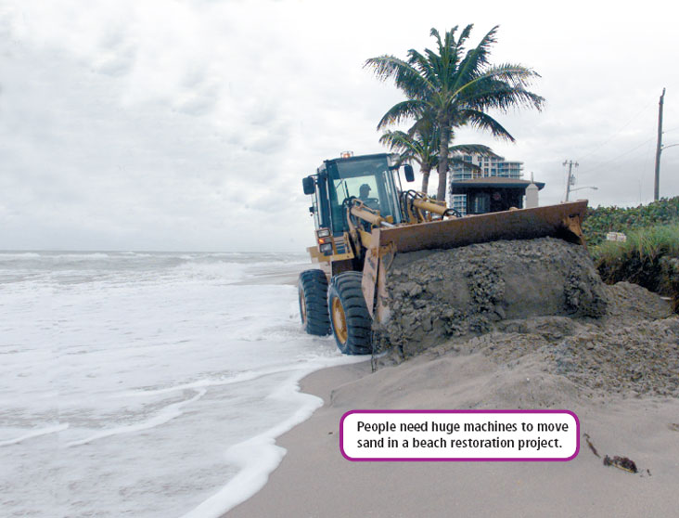

Slide 19
Beach Restoration
How to solve this:
Sand is dredged or scooped out of a channel and dumped onto a beach.
Workers use bulldozers to spread out the sand.
This process of replacing sand on a beach is called beach restoration.
It can cost millions of dollars, but many people think saving the beach is worth it.

Slide 20
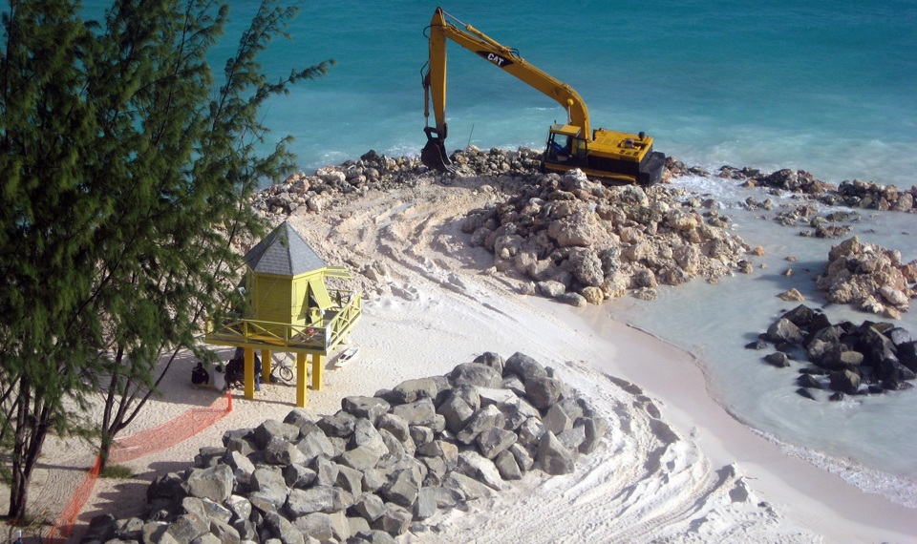

Slide 21
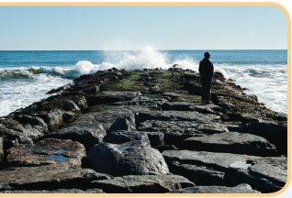
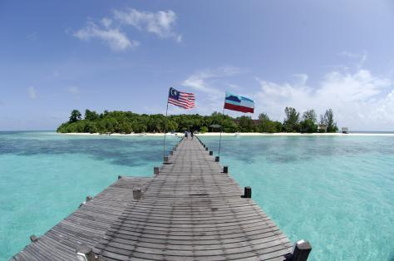
Beach Restoration
Beach restoration is not permanent.
Natural erosion takes over as soon as the work is finished.
After several years the process may need to be done again.
People have tried many ways to prevent beach loss, including building jetties.

Slide 22
Beach Restoration
A jetty is a wall-like structure that sticks out into the ocean.
Many jetties are built of large rocks.
As longshore currents move along the coast, the jetty traps sand and small rocks.
This protects particular beach, but because the current is blocked, beaches below the jetty don’t get the sand deposits they normally would.

