Slide 1
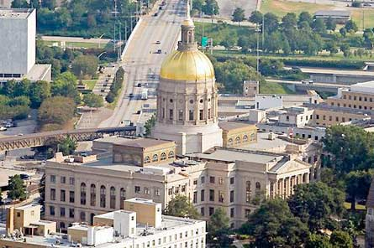
Chapter 3: Changes in Matter
Georgia State Capital, Atlanta GA
Lesson 1: What is matter made of?
Standards:
S5P1: Students will verify that an object is the sum of its parts.
S5P2: Students will explain the difference between a chemical change and a physical change.

Slide 2
Vocabulary Preview
Atom: smallest unit of an element, that has properties of that element
Molecule: a group of two or more atoms that are joined
Element: a substance made of only one kind of atom

Slide 3
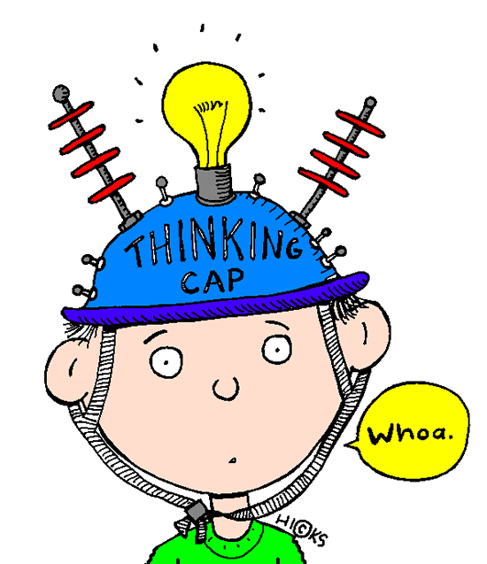
Basic Properties of Matter
What do your bed, the water in the ocean, and the air in your classroom all have in common?
Not much, but they are all examples of matter.
Matter is anything that has mass and takes up space.
Sunlight is NOT matter.
An idea is NOT matter.
Your brain doesn’t take up more space when you think hard.

Slide 4
Basic Properties of Matter
What is matter made of?
You know that it has different properties.
But how does it come together to make the things you see and touch?
Air is something around you everywhere.
You need it to breathe. You know it is matter.

Slide 5
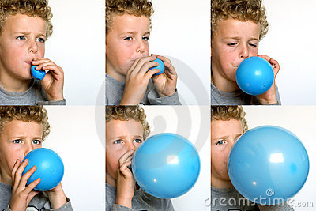
Basic Properties of Matter
The fact that you can squeeze more and more air into a container gives you a hint as to what matter is made of.
It hints at the size of the particles of matter.
You can’t see the particles.
With an air pump you can pack more and more of them into the same space.
So they must be very small.

Slide 6
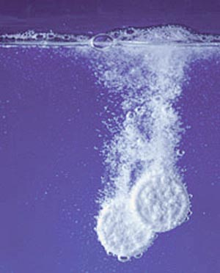
Basic Properties of Matter
Other properties of matter provide hints.
Substances have properties such as solubility , mass, and hardness.
Some particles must be heavier or hold together more tightly.
These difference are because the tiny particles that make up each substance are different.

Slide 7
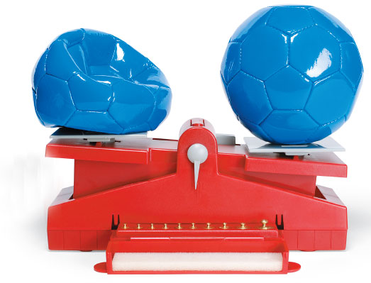
The soccer ball at the right has more mass than the one at the left. Where does the extra mass come from?
The two soccer balls on the next slide show you that you can squeeze different amounts of it into a container.

Slide 8
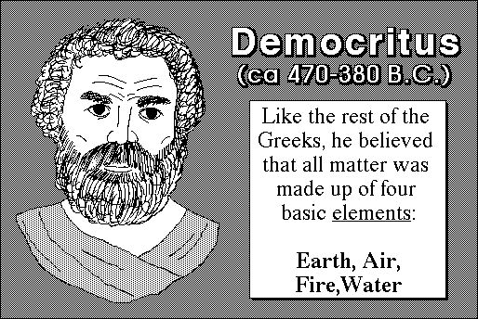
Particles of Matter
Over 2,000 years ago, a Greek thinker named Democritus had an idea about matter.
Democritus said that all matter is made up of tiny particles, or bits.
He said that different kinds of matter are made of different kinds of particles.
He thought that these particles could not be broken down into smaller pieces.
What do you think about this? Can they be broken down?

Slide 9
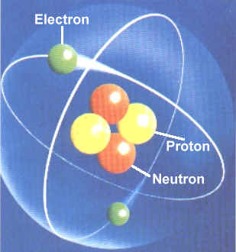
Particles of Matter
Democritus didn’t experiment or test his ideas in any way.
It turned out that he was right.
We know now that matter can be broken down, but only so far.
If you divide something smaller and smaller, you end up with an atom.
An atom: is the smallest possible particle of a substance.

Slide 10
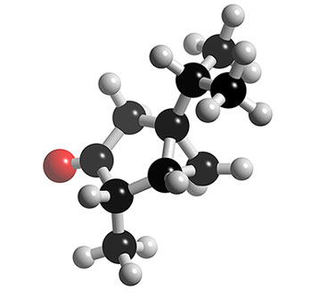
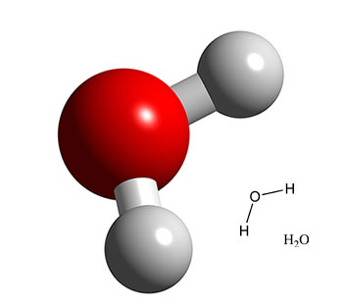
Particles of Matter
A molecule: is made up of two or more atoms joined together.
Atoms and molecules are very small.
You can not see them.
Even with a microscope you couldn’t see a molecule or atom.
This is because single atoms and molecules are too small to reflect light.
So there is no way you can see them unless you use a special microscope.

Slide 11
Particles of Matter
Democritus made up the word atom.
It comes from a word “cannot be divided”.
Think about a tank of oxygen.
You can divide all the oxygen inside into smaller and smaller parts.
But when you get to an oxygen atom, you have to stop.
If you break it up further, it wont be oxygen anymore.

Slide 12
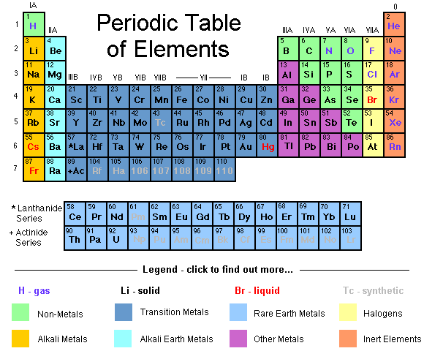
Elements

Slide 13
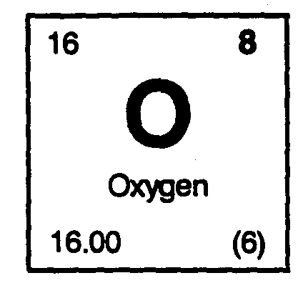
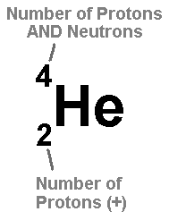
Elements
The smallest possible particle of water is a molecule made up of two different kinds of atoms-two hydrogen atoms and one oxygen atom.
Hydrogen and Oxygen are elements.
Element: is a substance that is made up of just one kind of atom.
A sample of oxygen is made up of many billions of oxygen atoms and hydrogen atoms joined together.

Slide 14
Elements
Water is not an element.
Scientists have identified 116 elements.
Some of them are familiar to you.
Iron is an element that can make horseshoes.
Gold is an element that makes jewelry.

Slide 15
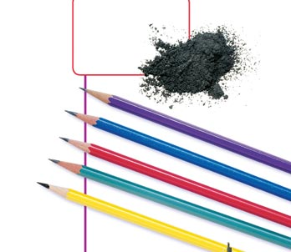
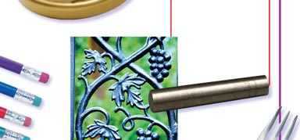
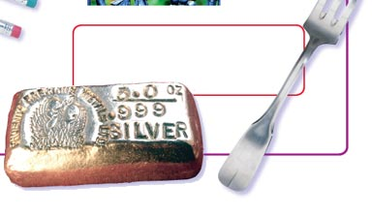
Remember the atoms in charcoal? They were carbon atoms. Carbon is also the element that makes up the point of a pencil.
Iron is another common element. You probably see things made of iron every day. You may also see things made of steel. Steel is made up of iron and a small amount of carbon
You’ve already read that oxygen is an element. It is one of several elements that people must have in order to live
Another shiny, silver-colored element is silver. Silver is somewhat rare. Many people call forks and spoons “silverware.” However, only fancy, expensive silverware is really made of silver

Slide 16
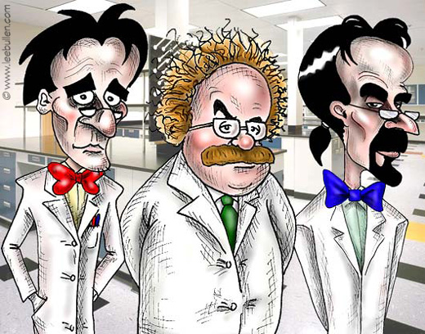
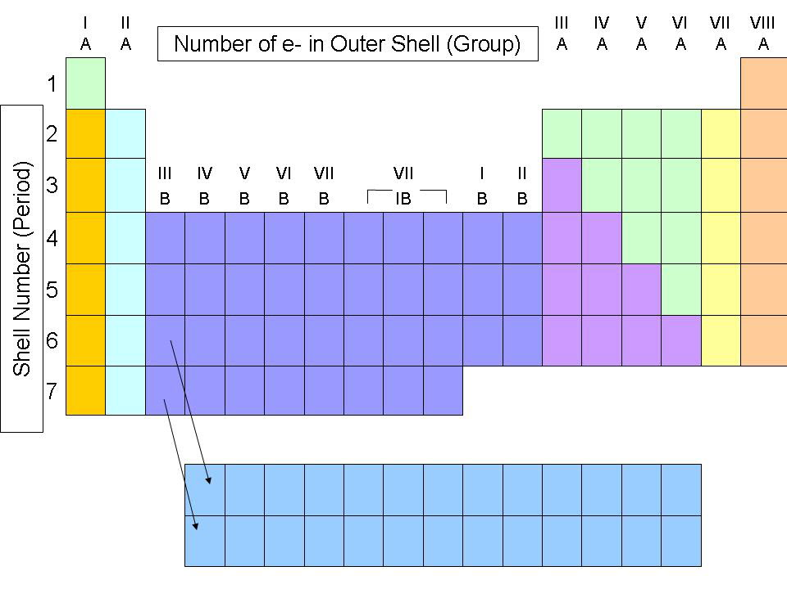
Some Groups Of Elements
Scientists have grouped elements in several ways.
One way divides elements into metals and nonmetals.
About 75% of all elements are metals!
Ex: gold, iron, and silver
However, not all elements are metal.
Ex: steel is made up of iron and carbon

Slide 17
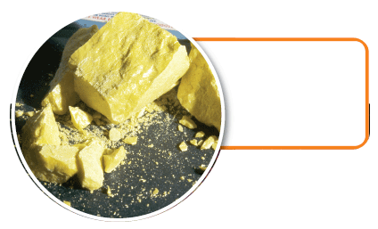
Sulfur is another element. It is a nonmetal. When ground into a powder, it is used to produce fireworks.
The noble gases are elements. When electricity is used with neon gas, it glows bright red. Argon gas glows yellow.

Slide 18
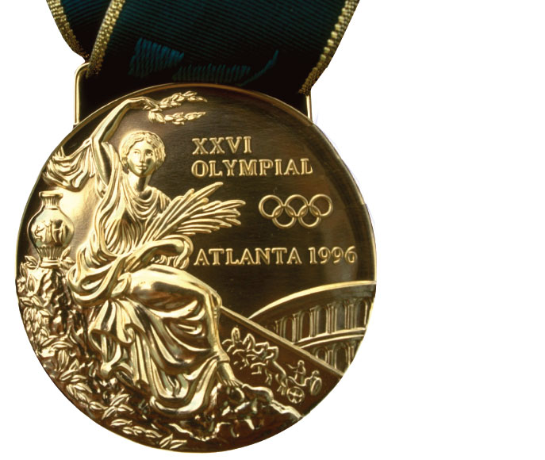
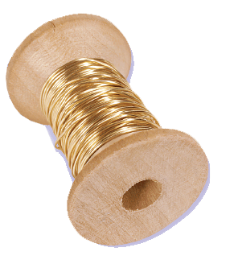
Gold is an element and a metal. It can be drawn out into thin wire and it is used in jewelry, coins, and electronics.

Slide 19
Metals
Here are some ways metals are alike:
Most metals are shiny. Ex: gold and silver (coins) they are coated with metal copper.
Most metals are malleable (they are easy to shape or form). Ex: they can be hammered of rolled into very thin sheets.
Most metals are ductile (they can be pulled into thin strands) such as wires without breaking.
Also electricity can travel through metal.

Slide 20
Non Metals
Nonmetals are different from metals.
Nonmetals are not shiny. They are dull.
They can’t be pounded or stretched out.
They break easily.
Nonmetals don’t conduct electricity easily.

Slide 21
Noble Gases
The noble gases are another group of elements.
These six elements are neither metals nor nonmetals.
They are unique because they are colorless and odorless.
However, when electricity is added to some of them, like neon and argon, they GLOW!

