Slide 1
Chapter 5 Lesson 3 “Compromise and Conflict”
pgs. 156-159
EQ: Would conflict spread between the north and the south over the spread of slavery?

Slide 2
Vocabulary Preview
Slave state: permitted slavery
Free state: did not permit slavery
Union: another name for the United States
Popular Sovereignty: the right of people to make political decisions themselves

Slide 3
Build on What you Know
In order to solve a disagreement, you give a little to get something back. This is known as a compromise.
During the 1800s, Congress (law makers) made several compromises over slavery in order to keep the country together.

Slide 4
Would Slavery Spread?
The US grew in the 1800s. The Louisiana Purchase and the Mexican War had opened new lands to settlers.
Congress set up governments for these news lands and some regions became territories.
When a territory’s population became large enough, it could become a state.
Congress then needed to decide whether to allow slavery in each territory.

Slide 5
Slave State or Free State?
Territories that allowed slavery became known as slave states. A slave state permitted slavery.
Territories where slavery was illegal was known as a free state. Free states did not permit slavery.
For a time, Congress tried to keep an equal number of free and slave states.

Slide 6
Compromises in Congress
During the first part of the 1800s, Congress argued over which territories would have slavery.
Northerners wanted free states to have a majority of representative in Congress, so they could pass laws against slavery.
Southerners wanted the opposite and more slave states.

Slide 7
Compromises in Congress *also watch the video right below this one
Missouri wanted to join the Union as a slave state. Union=another name for the US.
To satisfy both sides, Congress created the Missouri Compromise of 1820. It accepted Missouri as a slave state and Maine as a free state.
Congress made an invisible line across the rest of the territories. Only territories south of that line would allow slavery.
Congress continued to debate the spread of slavery into new territories.

Slide 8
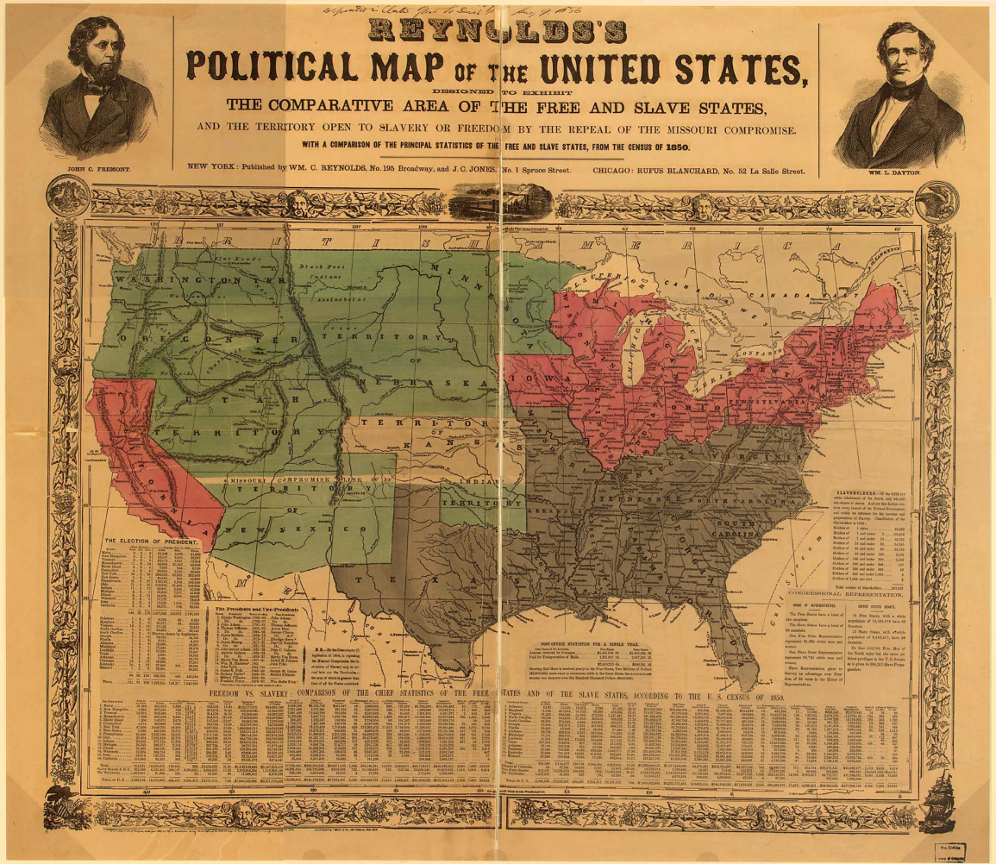
More Compromises
In the Compromise of 1850, Congress allowed settlers in some territories to make the decisions for themselves. The right of people to make political decisions for themselves was called popular sovereignty.
In 1854, Congress passed the Kanas Nebraska Act. This law gave popular sovereignty to the Kanas and Nebraska territories.
Abolitionists opposed the act because it allowed slavery north of the line created during the Missouri Compromise.
Click the map for a bigger view

Slide 9
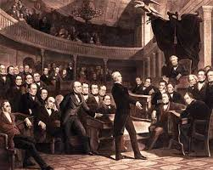
More Compromises
Settlers supporting and opposing slavery rushed into Kanas. Both sides wanted to win the vote on whether to allow slavery.
Soon the two sides fought for control of the territory. In 1861, Kanas joined the Union as a free state.
Henry Clay was known as the Great Compromiser. Kentucky senator tried to keep arguments over slavery from dividing the nation.

Slide 10
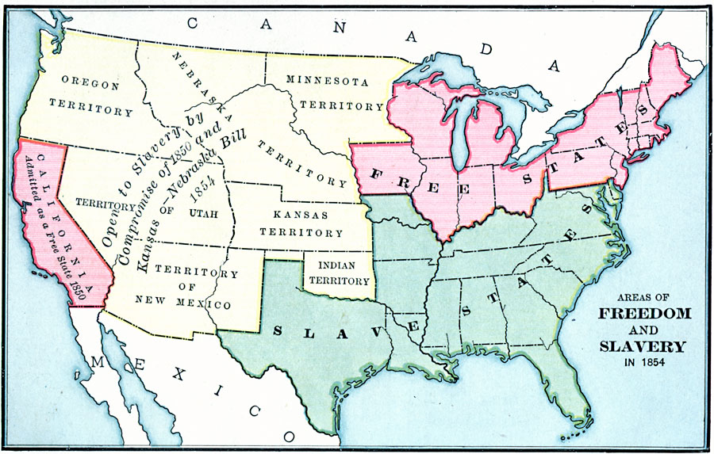
Free and Slave States

Slide 11
Table Talk
What compromised did Congress make as the nation grew?
The Missouri Compromise, Compromise of 1850, and the Kanas-Nebraska Act
Turn to page 157 in your book to view the maps.

Slide 12
Growing Crisis
As part of the Compromise of 1850, Congress passed the Fugitive Slave Law, which upset Northerners.
A fugitive is a person who is running away.
The law said that slaves who had escaped to the North had to be returned to slavery. The Fugitive Slave Law also ordered citizens to help catch fugitives. Many Northerners refused to obey the law.

Slide 13
Growing Crisis
Harriet Beecher Stowe, a writer was against the Fugitive Slave Law. She wrote a story about the cruelty of slavery.
Her book, Uncle Tom’s Cabin, sold 300,00 copies in one year. Stowe pointed out in the book that slavery was not just the South’s problem.
Uncle Tom’s Cabin convinced many northerners that slavery was wrong. Some southerners insisted that Stowe’s picture of slavery was false.
Arguments over the book pushed the North and the South further apart.

Slide 14
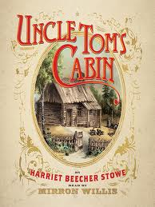
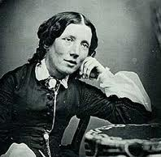
Harriet Beecher Stowe
http://www.youtube.com/watch?v=ijFy4RjYGbQ

Slide 15
Dred Scott
A legal case about slavery came to Supreme Court in 1857. Dred Scott, an enslaved man from Missouri, asked the court for his freedom.
Scott argued that he should be free because he once lived in Illinois, a free state.
The Supreme Court disagreed, it said that enslaved people were property, and that living in a free state didn’t make them citizens.
The Supreme Court said that the government couldn’t keep slavery out of any territory because that would prevent slave-owners from moving their property to new territories.

Slide 16
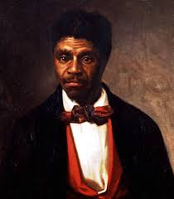
Dred Scott
The Dred Scott decision was a victory for slave owners. It meant that slavery had to be legal in all territories, even if most settlers didn’t want it.
Abolitionists feared that slavery would spread over the whole country.

Slide 17
John Brown’s Raid
An abolitionist named John Brown decided to fight against slavery on his own. In 1859, he tried to start a rebellion against slavery by attacking a US Army Post at Harpers Ferry, Virginia.
Soldiers quickly surrounded and captured him.
The government accused Brown of treason. He was found guilty and hanged.
Many Northerners saw him as a hero, but Southerners saw him as a violent man.
By 1860, the North and South were deeply divided.

Slide 18
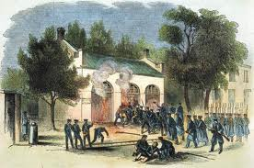
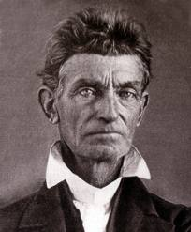
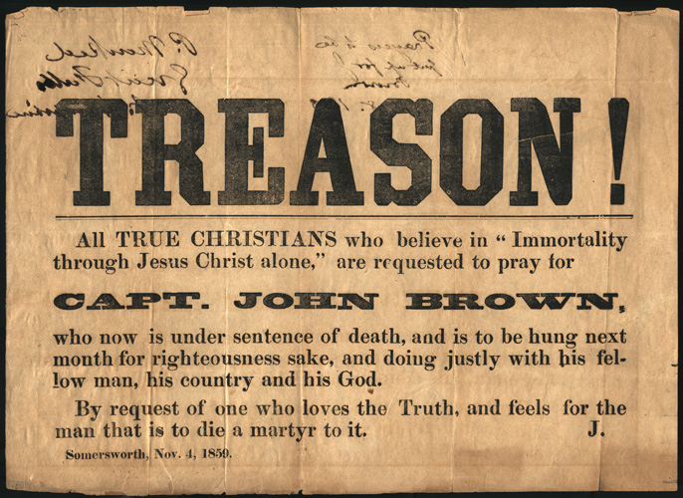
John Brown

Slide 19
Table Talk
Why did John Brown attack Harpers Ferry?
He wanted to start a rebellion against slavery
What effect did Harriet Beecher Stowe’s book have on the debate over slavery?
Her book made many northerners oppose slavery more than before and angered many southerners.

Slide 20
Read “A Troubling Law”
Pg. 160
While reading make predictions about each character’s feelings about the Fugitive Slave Law.

