Slide 1
Chapter 5 Lesson 4 Civil War Begins
EQ: What were the events that led to the secession of the Confederate states?

Slide 2
Vocabulary Preview
Secession: when part of the country leaves or breaks off from the rest
Confederacy: was formed by 11 southern states who left the union (US)
Civil War: a war between opposing groups of the same country

Slide 3
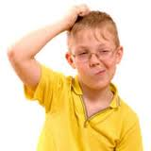
Build on What you Know
You know that strong beliefs can make a difference in peoples’ lives. President Lincoln strongly believed that the Union should not be allowed to split apart.
When Southern states tried to leave the Union, Lincoln went to war to stop them.

Slide 4
Abraham Lincoln
By 1860, the conflict over slavery was getting worse. John Brown’s raid had worried people in the South.
They thought abolitionists wanted to start slave rebellions.
Southerners believed that secession was the only way to protect their states’ rights and continue as a slave-owning region.
When a country leaves or breaks off from the rest it is called secession.

Slide 5
Lincoln
Northerners were also upset and didn’t like the Kanas-Nebraska Act and the Dred Scott decision.
They feared slavery would spread across the country.
The Republican party was formed and they wanted to keep slavery out of the territories.
Abraham Lincoln was a famous Republican and was one of the most famous leaders of the US.

Slide 6
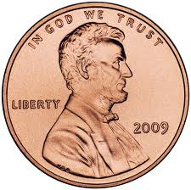
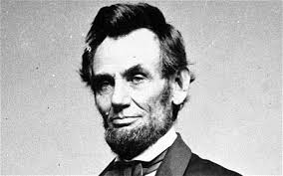
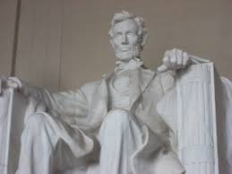
Abraham Lincoln
http://app.discoveryeducation.com/search?Ntt=abraham+lincoln&N=18341
*Animated Hero Series

Slide 7
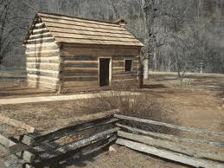
Lincoln’s Early Years
He was born in a small cabin in Kentucky, a slave state. They later moved to Indiana and then to Illinois, both free states. His father was a farmer. As a boy he worked on his father’s farm. He loved reading, and read all the book he could.
He didn’t want to be a farmer, but instead a lawyer. Also, he wanted to be a part of the legislature. He won his first election at 25 and served four years.
Later, Lincoln served one term as a representative in the US Congress. He argued against allowing slavery to expand.

Slide 8
Table Talk
Why did southerners want their stated to withdraw from the Union?
They believed secession was the only way to protect slavery.
What did Republicans think about slavery in the territories?
Republicans wanted to keep slavery out of the territories.
In what states did Abraham Lincoln’s family live while he grew up?
Kentucky, Indiana and then Illinois

Slide 9
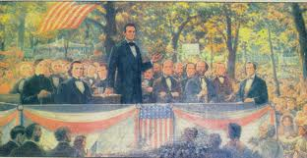
Lincoln’s Campaign
Abraham ran for office after the Kanas-Nebraska Act passed. In 1858, he ran for the Senate in Illinois as a Republican against Stephen Douglass.
The two men held seven debates and argued about slavery.

Slide 10
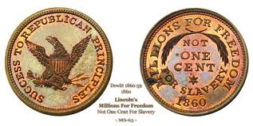
Debate
Antislavery medals in 1860
Douglas
Wanted popular sovereignty
Wanted slavery
Country could remain spilt over slavery
Lincoln
Hated slavery
Didn’t want slavery to spread
Believed slavery would end on its own if it were not allowed to spread

Slide 11
Lincoln’s Words
“A house divided against itself cannot stand. I believe this government cannot last permanently half slave and half free…it will become all one thing, or all the other”
What did Abraham Lincoln mean when he said “A house divided against itself cannot stand”?
He meant that a country couldn’t go on forever divided by slavery.

Slide 12
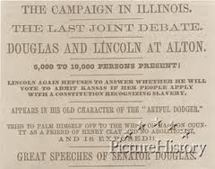
Poster Design
Campaign posters are one of the earliest forms of advertisements. Their purpose was to make people vote for a candidate for public office. Students need to pick either Douglass or Lincoln and create a campaign poster for their candidate.
The seven debates made history, attracting large crowds. The last debate was October 15, 1858. After two months of traveling across the state of Illinois and debating, Lincoln spoke these famous words….”Has anything ever threatened the existence of this Union save and accept this very institution of slavery? That is the real issuel.

Slide 13
Divided Nation
Lincoln lost the election to Douglas, but the debates made Lincoln famous.
Reporters printed what the two men said and people read his words. Northerners agreed with his views on slavery and people in the South saw him as an enemy.
In 1860, the country held an election for President. The Democratic party couldn’t choose just one candidate: North chose Stephen Douglas and South: John Breckinridge (he own slaves).
The Republican party chose Lincoln (he was the only one against slaves.

Slide 14
Divided Nation
Lincoln had support in the North, but very little in the South. In 10 southern states, voters were not given Lincoln’s name as a choice.
He won the election, but the result showed how divided the nation was. He didn’t win a single southern state. Southerners thought his election was a disaster.
When Lincoln was president, they feared that the government would grow stronger and that Lincoln would try to end slavery. They believed the secession was the only was to protect their rights.

Slide 15
Table Talk
Who were the democratic candidates for Presidents in 1860?
Northerners: Stephen Douglas
Southerners: John Breckenridge
Why would it have been difficult to vote for Lincoln in the South?
Voters in 10 states were not even given his name as a choice.

Slide 16
Secession Begins
South Carolina withdrew from the Union first. People there voted to leave on December 20, 1860.
Mississippi, Florida, Alabama, Georgia, Louisiana, and Texas soon did the same.
February 4, 1861, delegates from the 7 states met in Montgomery Alabama and voted to form their own confederation.
In the confederation, the states would have more power than the central government.
The called themselves the Confederate States of America and they elected Jefferson Davis as president.

Slide 17
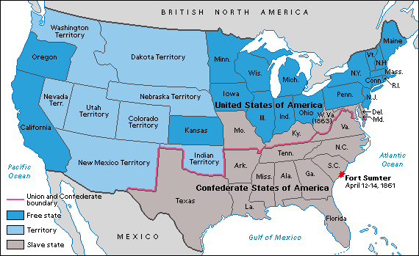
Union and Confederates

Slide 18
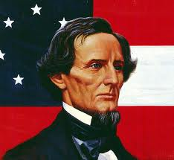
Jefferson Davis
After serving as an officer in the Mexican War, he became a senator from Mississippi and argued for states’ rights.

Slide 19
Attack on Fort Sumter
President Lincoln was determined to find a way to hold the country together. It was too late though.
In Charleston, South Carolina, the state militia had surrounded Fort Sumter, a federal fort with the US soldiers inside.
The Confederate government wanted control of the fort, but Lincoln refused. Instead, he sent a ship with supplies to the fort.
He wanted to show he wouldn’t give in to the Confederates.

Slide 20
Fort Sumter
Confederates saw the refusal to surrender the fort as an act of war. They ordered cannons to fire on the fort. The first shot was fired on April 12, 1861.
The cannons fired for 34 hours. The soldiers at the fort had to surrender.
The marked the beginning of the Civil War.
A civil war is a war between two groups within a region.
President Lincoln called for 75,000 soldiers to fight the rebellion. Citizens in the North and South prepared to fight.

Slide 21
