Slide 1
Chapter 6 Lesson 1 “A Nation At War” pgs. 176-181
EQ: Why was the nation at war? What advantages did the South and North have over each other?

Slide 2
Vocabulary Preview
Border states: these were slave states that stayed in the union
Casualties: soldiers who are killed or wounded
Draft: the government selects people to serve in the military
Emancipation: the freeing of enslaved people

Slide 3
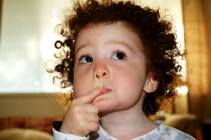
Build on what you know
Have you ever started a task that was harder than it seemed at first? At the start of the Civil War, both sides thought they could win quickly. Soon they realized that winning the war would be far from easy.

Slide 4
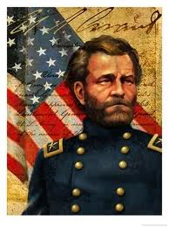
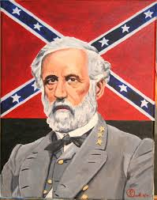
North Against South
North
South
22 million people lived there
More factories for weapons and supplies
More railroad lines than the South (soldiers and supplies moved more quickly)
Ulysses S. Grant war general
9 million people lived there (1/3 were slaves who couldn’t fight
Most of the fighting took place in the South
Confederates were defending land they knew
Excellent military leaders (General Robert E. Lee and Stonewall Jackson)

Slide 5
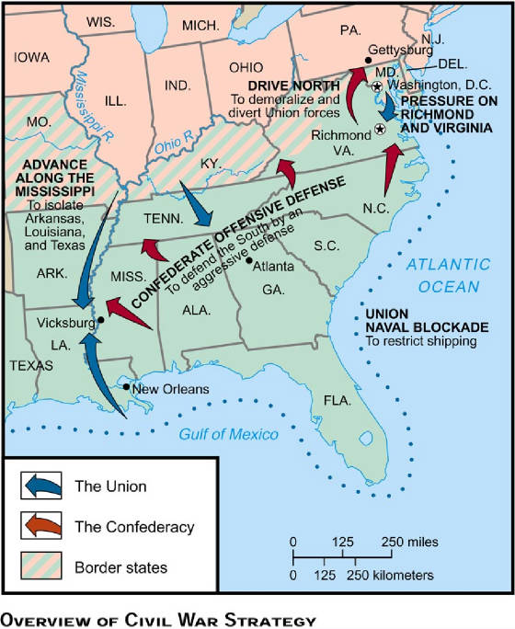
Plans for war
Union plan: defeat south by blocking southern seaports so they couldn’t trade with countries
Confederate plan: win the battles and hope for help from France and Britain because they needed their cotton

Slide 6
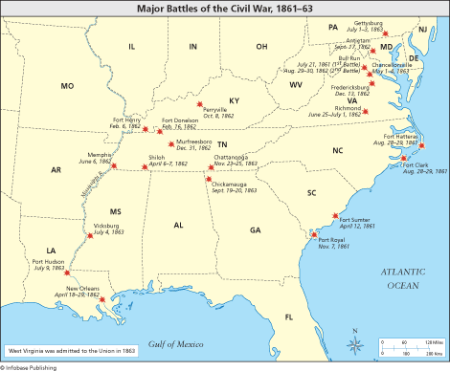
Early Battles of 1861-1863

Slide 7
War in the east
Both sides expected a quick victory and thousands joined the Union and Confederates.
July 1861: Union army marched to Richmond, Virginia to a place called Bull Run. The very first battle between the two was the Battle at Bull Run.
General Thomas Jonathan Jackson led Confederates and he “looked like a stonewall” and became known as Stonewall Jackson.
Confederates won this battle.

Slide 8
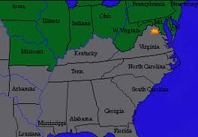
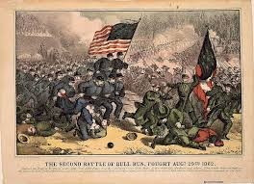
Bull Run

Slide 9
War Leaders
1862: General Robert E. Lee defeated two Union attacks on Richmond. Stonewall also beat several Union armies.
Lee decided to invade Maryland next.
A Union army stopped him at the Battle of Antietam. It was the deadliest battle with 23,000 casualties (wounded or killed). Lee’s weakened army returned to Virginia.

Slide 10
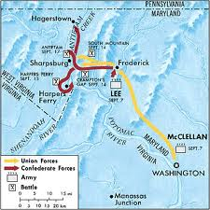

Slide 11
War in the west
Union army and navy were successful in West.
General Ulysses S. Grant led a Union army south of Illinois and captured forts including the Battle of Shiloh where there was a large confederate army.
Union navy sailed up the Mississippi River and attacked New Orleans and then captured Vicksburg, Mississippi. Once Grant captured Vicksburg he could control the river.

Slide 12
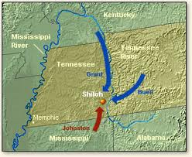
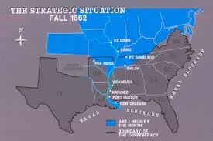

Slide 13
Government Responds
Jefferson Davis the president of the Confederacy faced many problems. The Union blockade closed most Confederate ports.
South had trouble getting food, weapons and money.
Not many people wanted to join the army so a draft was done: government select people to fight.
Lincoln also had to start a draft and he needed to continue to work for support for the war.

Slide 14
Turning Point
Lincoln’s goal was to keep the Union together.
He didn’t plan to free enslaved people, but in 1862 he changed his mind.
Lincoln put the Emancipation Proclamation into effect on January 1, 1863. This freed all enslaved people.
The Proclamation declared the slaves in the Confederacy were free, but the North would have to defeat the South.

Slide 15
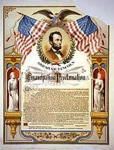
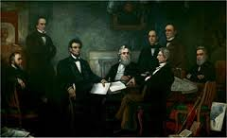
Emancipation proclamation

Slide 16
Vicksburg and gettysburg
1863: Union won two important battles: Vicksburg (Union now controlled the Mississippi River) and this cut off Texas and Arkansas from the rest of the South.
Union armey met Lee’s soldiers of July 1, near the town of Gettysburg and killed about half the Confederate soldiers.
July 1863 was a turning point of the war. It gave the Union a better chance of winning.

Slide 17
Gettysburg address
Later that year Lincoln gave a short speech at Gettysburg, known as the Gettysburg address. He declared the Union was fighting to make sure that American democracy would survive. The speech is famous as a powerful statement about the purpose of the Civil War.
Read the speech on page 183.

Slide 18
Four score and seven years ago our fathers brought forth on this continent, a new nation, conceived in Liberty, and dedicated to the proposition that all men are created equal.
Now we are engaged in a great civil war, testing whether that nation, or any nation so conceived and so dedicated, can long endure. We are met on a great battle-field of that war. We have come to dedicate a portion of that field, as a final resting place for those who here gave their lives that that nation might live. It is altogether fitting and proper that we should do this.
But, in a larger sense, we can not dedicate -- we can not consecrate -- we can not hallow -- this ground. The brave men, living and dead, who struggled here, have consecrated it, far above our poor power to add or detract. The world will little note, nor long remember what we say here, but it can never forget what they did here. It is for us the living, rather, to be dedicated here to the unfinished work which they who fought here have thus far so nobly advanced. It is rather for us to be here dedicated to the great task remaining before us -- that from these honored dead we take increased devotion to that cause for which they gave the last full measure of devotion -- that we here highly resolve that these dead shall not have died in vain -- that this nation, under God, shall have a new birth of freedom -- and that government of the people, by the people, for the people, shall not perish from the earth.

