Slide 1
Chapter 6 Lesson 2 “The Human Face Of War” pgs. 184-187
EQ: What were the conditions that soldiers faced during the Civil War?

Slide 2
Vocabulary Preview
Camp: a place where tents or other temporary shelters are set up, especially for soldiers
Home Front: the civilian population or the civilian activities of a country at war
Civilian: a person not serving in the armed forces

Slide 3
Building Background
Have you ever missed someone or waited for a card from a friend or family member? If you have, then you know part of what it was like to live during the Civil War. During the war, soldiers and their families missed each other’s company.

Slide 4
The Soldier’s Life
Men fought from all parts of the country. Many hoped for excitement, instead they found terror and boredom at camp: temporary shelter such as tents.
Soldiers read, sang, or wrote letters to pass time.
Food in the army was usually poor. Union soldiers ate the same thing everyday. Confederate soldiers suffered because they usually didn’t have enough to eat.

Slide 5
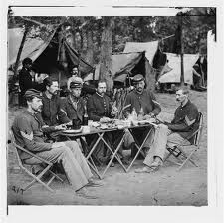
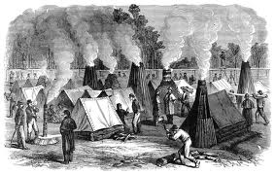
Camp life

Slide 6
Who were the soldiers?
Soldiers came from many different backgrounds. At first almost all were white and born in the US.
As the war went on the Union allowed African Americans in the war and about 180,000 served.
Immigrants also joined the Union army (people from Germany, Italy, Ireland)
Thousands of boys went into battle even though they were too young. Women disguised themselves as men in order to join the war.

Slide 7
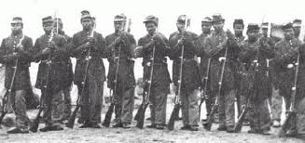

Slide 8
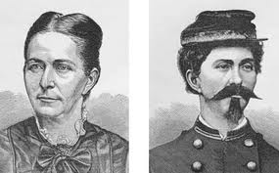
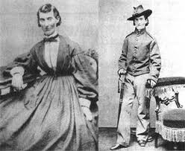

Slide 9
Casualties of War
The Civil War was the deadliest war in American history. Rifles could shoot farther and more accurately than ever before.
Casualties were much higher because diseases. Women helped care for the sick and wounded. More than 3,000 northern women served as nurses. Clara Barton, who founded the Red Cross helped care for the wounded.
Thousands of families lost loved ones.

Slide 10
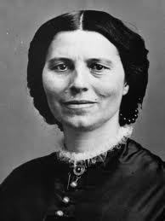
Clara Barton

Slide 11
Table Talk
What did soldiers do to fight the boredom of camp life?
What are some countries that immigrants who joined the Union army came from?
What made the Civil War so deadly?

Slide 12
On the Home Front
Many soldiers left their families behind when they went to war. Those families were part of the home front. When a country is at war, the home front is all the people who are not in the miliatry.
With the men gone, women took on new task such as sewing uniforms, knitting socks, making bandages, raised money for the armies, and ran businesses.
Most of the battles during the war were in the South. Few people in the North could see the war happening.

Slide 13
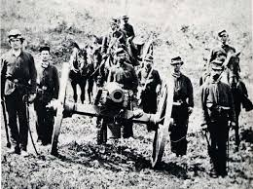
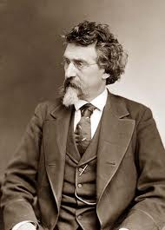
Home front
A civilian is a person who is not in the military.
Matthew Brady took pictures if soldiers, camp life, and battlefields. He showed his photographs in the North. Civilians there saw that the war was much worse than they realized.

Slide 14
Southern Home Front
Life on the home front was hard in the South.
Their farms became battlefields and their cities, homes, and barns were destroyed.
The soldiers and civilians didn’t have enough to eat and inflation or rise in prices, made food very expensive.
The money printed by the Confederate government because almost worthless.

Slide 15
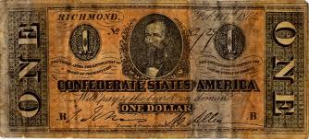
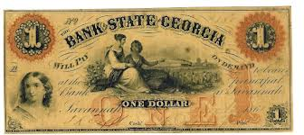
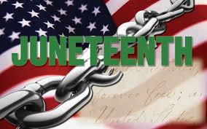
Southern Home Front
A barrel of flour that cost $6 in 1861 might have cost $1,000 in 1865.
In some towns like Richmond, people attacked shops in search of food.
Enslaved people also suffered, most were welcomed to join the war. The Emancipation Proclamation freed them.
News of the Proclamation reached Texas on June 19, 1865. The was a day of celebration because it was the day slavery ended.

