Slide 1
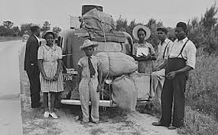
Chapter 6 Lesson 5 “The Challenge of Freedom” pages 206-209
EQ: What did freed African Americans do for work? What is sharecropping?

Slide 2
Vocabulary Preview
Sharecropping: a system of farming where a tenant farmer pays a share of the crops as rent to the landowner
Jim Crow: the practice of discriminating against the segregating African American after Reconstruction
Segregation: the practice of separating a group of people from the rest of society

Slide 3
Freedom and Hardship
African Americans sang with joy to celebrate their new freedom. Reconstruction was a time of hope for them. Slavery had ended and it was a chance for a new life.
Freedom was exciting, but it wasn’t easy because African Americans had to find a way to make a living. Also they had to prepare for their new roles as citizens.
They worked to educate themselves and took part in politics.
Times were hard because many Southerners didn’t want former slaves to be citizens.

Slide 4
Rise of Sharecropping
Reconstruction put an end to the plantation system in the South, leaving many poor.
Freed people wanted to farm for themselves. However, many didn’t have enough money to buy land.
Landowners set up a system called sharecropping that let poor whites and former slaves become farmers.
In return, the farmer gave the landowner a share of the crop. Landowners often loaned sharecroppers tools and seeds as well.

Slide 5
Sharecropping
Sharecropping gave African American independence and it also kept poor farmer in debt.
After selling their crops, many sharecroppers didn’t have enough money to pay the landowners what the owed.
They had to keep borrowing and couldn’t get out of debt. Sharecropping made it hard for poor farmers to save money and provide a good life for their family.

Slide 6
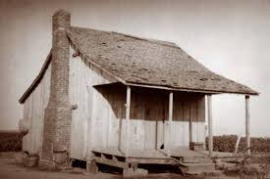
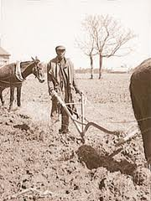
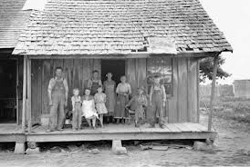
Sharecropping

Slide 7
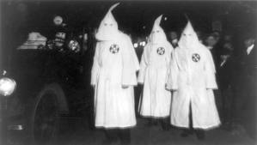
Responses to Reconstruction
Reconstruction angered some people in the South. They opposed the new laws that protected African Americans’ rights. They also disliked the soldiers in the south that enforced the laws.
Some wanted to stop African Americans from taking part in the government and formed secret groups like the KKK(Ku Klux Klan).
They threatened, beat, and even killed African Americans to keep them from voting.

Slide 8
Table Talk
What benefits did landowners and poor farmers get from sharecropping?
Why did sharecroppers stay poor?
What was the KKK?

Slide 9
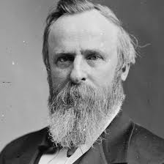
End of Reconstruction
People were frustrated because they felt that Reconstruction wasn’t uniting the nation.
1877: Rutherford B. Hayes ended reconstruction and ordered government soldiers to leave the south.
Without protection, many African Americans were unable to vote and lost their political power.
Southern states passed Jim Crow laws which was a nickname for laws that kept African Americans separate from other Americans.

Slide 10
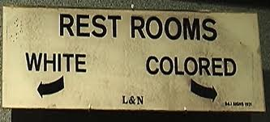
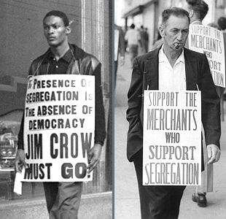
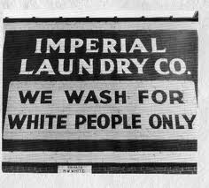
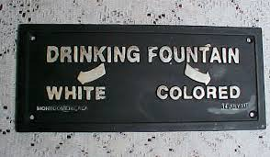
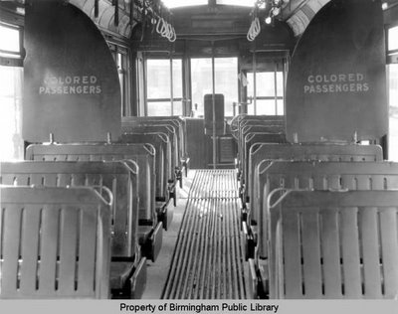
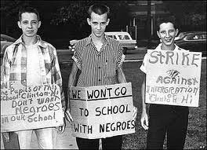
Jim Crow Laws

Slide 11
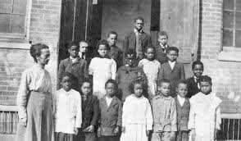
Segregation
These made segregation legal.
Segregation is the forced separation of the races. Jim Crow laws segregated schools, hospitals, and even cemeteries.
States usually spent less money on schools and hospitals for African Americans.

Slide 12
New Schools
African Americans didn’t want the Jim Crow laws to ruin their hopes of being educated and having a future.
Churches in the North sent money and teachers to support the schools.
A former slave named Booker T. Washington opened the Tuskegee Institute in Alabama.
All of the teachers and students were African American and would receive equal treatment.

Slide 13
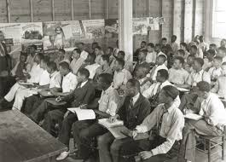
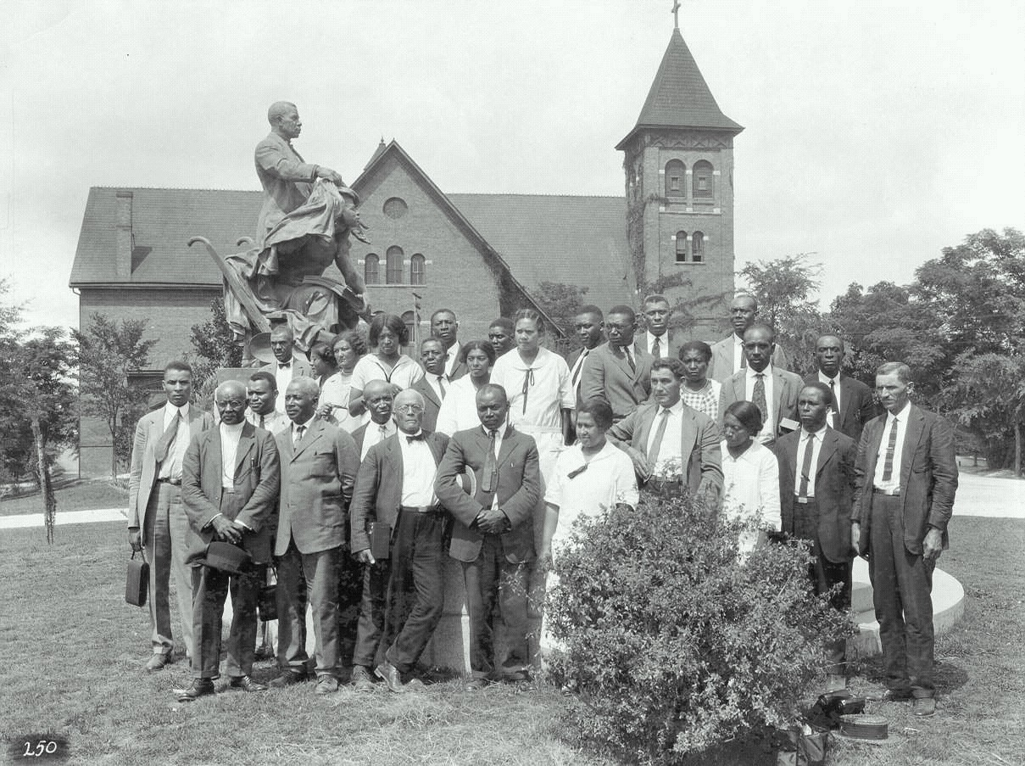
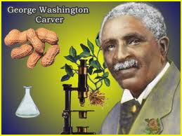
Tuskegee Institute

Slide 14
Most Famous Teacher
George Washington Carver was a teacher at the Tuskegee Institute.
Carver studied how to improve the lives of poor farmers.
He taught them how to grow crops such as peanuts, pecans, and sweet potatoes.
He invented over 300 products made from peanuts including: peanut butter, peanut cheese, and peanut milk.
He helped farmers across the South.

