Slide 1
Chapter 7 Lesson 1 Linking East and West pages 222-226
EQ: How did the telegraph helped Americans communicate? Explain how the transcontinental railroad was built and its effects on the nation?

Slide 2
Vocabulary Preview
Transcontinental: going across a continent
Prejudice: suspicion or hatred of a particular race, religion, or group

Slide 3
TELEGRAPH HELPS COMMUNICATION
In the early 1800s, letters and news traveled by horse, stagecoach, or steamboat. It could take days or weeks to send a message.
1844: Samuel Morse amazed people by sending a message from Washington to Maryland in seconds. Morse used a telegraph to send his message.
Telegraph: it was a machine that sends electric signals over wire telegraph lines.

Slide 4
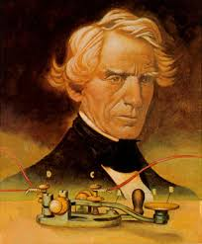
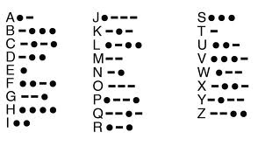
Samuel Morse
Take a minute and try to write your name in morse code.

Slide 5
Transcontinental Railroad
Many pioneers were heading west by the 1840s and some were looking for gold. Others were looking for new places to settle.
To get to the West, many people sailed, others used railroads and then continued by wagons pulled by horses, mules, or oxen.
The trip was long, slow, unsafe, and expensive.

Slide 6
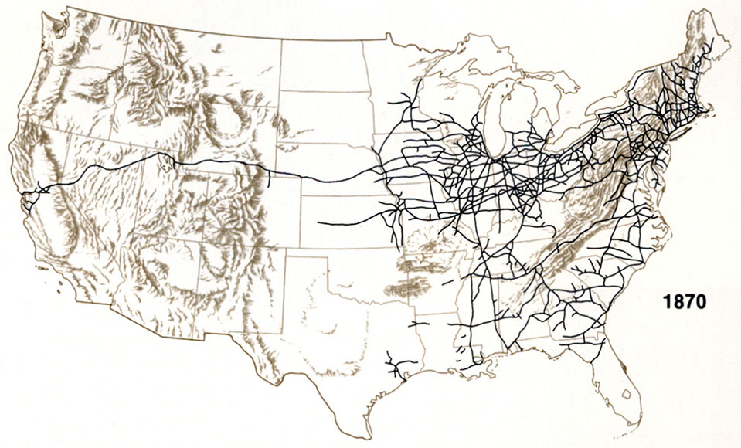
Major U.S Railroads, 1869
The line on the left was the Transcontinental Railroad and the lines on the right were other railroads. There was not a railroad yet that linked the East to the West.

Slide 7
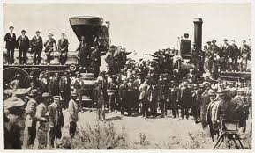
Transcontinental Travel, 1869
Method of Travel | Travel Time
Ship | Six months
Railroad and wagon | Five months
Transcontinental railroad | Eight days

Slide 8
Two Railroad Companies
A group of entrepreneurs in California wanted to earn money by building a transcontinental railroad. This was a railroad that crosses a continent.
The railroad would make travel easier from California to the East.
The group asked Congress to help by giving them money and land.

Slide 9
The Race Is On
1862: Congress passed the Pacific Railway Act and this said that the government could loan money to the Union Pacific and Central Pacific railroad companies.
Congress told the Central Pacific to start in California going from west to east.
The Union Pacific would start from east to west starting in Nebraska.
Rails built by these two companies would meet to build the transcontinental railroad.

Slide 10
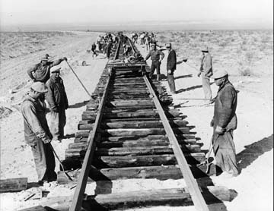
Union Pacific
They hired thousands of former soldiers and freed African Americans. Irish immigrants also moved west to work on the railroad.

Slide 11
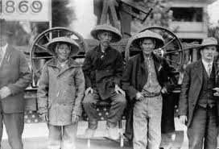
Central Pacific
They hired many Chinese workers. Thousands of Chinese people had come to California to search for gold. The Chinese faced prejudice (an unfair treatment or opinion that can lead to unjust treatment) from other railroad workers.
The Chinese were paid less and were given dangerous jobs such as using explosives.

Slide 12
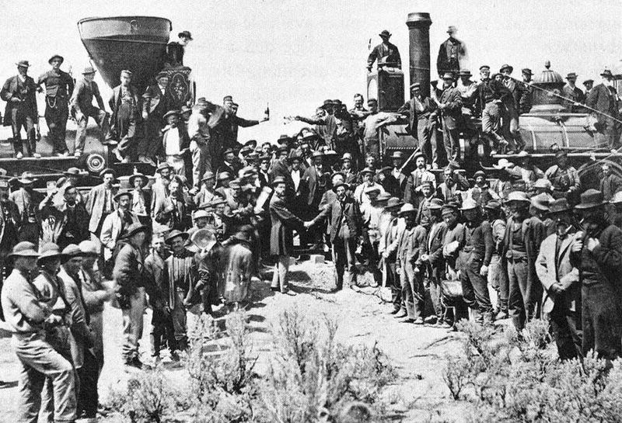
Joining of the Tracks
On May 10, 1869, both tracks were joined at Promontory Point, Utah. Railroad officials tapped spikes of gold and silver into the last piece of track. The two locomotives, one traveling west, and the other traveling east, slowly moved forward until they met.

Slide 14
Effects of the Railroad
The railroad was the first of several transcontinental railroads that would be built in the US. These railroads made it easier to travel and move goods and people across the country.
The railroads helped settlers in the East earn money by shipping their goods to markets.
Trains carried cattle and wheat to other eastern cities.
Western farmers and ranchers could sell their products for more money in the East, where there were more people and fewer farms.

