Slide 1
Chapter 7 Lesson 2
“Life on the Great Plains” p. 230-235
EQ: What groups of people settled on the Great Plains and why did they settle there?

Slide 2
Vocabulary Preview
Homestead: frontier land claimed by a settler
Exodusters: term used by African American settlers on the Great Plains to describe themselves
Drought: long period when almost no rain falls and crops can’t grow properly
Sodbuster:

Slide 3
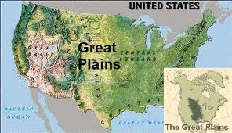
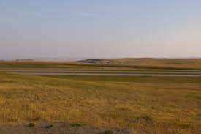
Settling the Great Plains
The Great Plains are located in the middle of the US, stretching from Texas to Canada. It is a flat land covered by grass and only receives 20 inches of rain or less a year.
At first people passed right through this area when settling because they thought it’d be bad for farming. Also, they believed it’d be difficult to build houses because there wasn’t much wood.

Slide 4
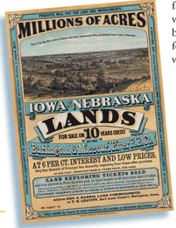
Primary Document
This pamphlet was used to sell millions of acres of land.
Where is the land located?

Slide 5
Homestead Act
1862: Congress passed the Homestead Act. A homestead is a settler’s home.
The Homestead Act offered 160 acres of land to adults who were U.S citizens or wanted to become citizens.
To claim the land, settlers had to pay a small amount of money and farm the land for 5 years and after that it was theirs.
The Homestead Act was a price incentive, when prices affect the decisions people make, they are called incentives.
By offering land at a low price, it encouraged more people to settle in the Great Plains.

Slide 6
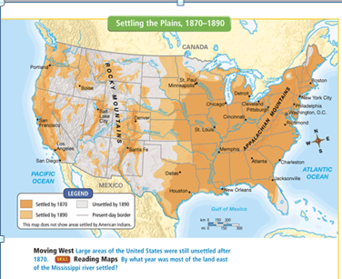
European settlers came to the Great Plains from Germany, Sweden, Norway, Denmark, and the Netherlands in search of land. Between 1860 to 1890 the population of Nebraska alone grew by over a million.

Slide 7
Table Talk
What special offer did the Homestead Act make to encourage settlement of the Great Plains?
Adult citizens of the US and immigrants who wanted to become citizens could get 160 acres of land by making a small payment and farming the land for 5 years.

Slide 8
Exodusters
African Americans in the South also wanted to start farms on the Great Plains. It was difficult after Reconstruction for African Americans. Most were poor and did not own any land. They also faced prejudice and violence. Some were even killed for starting businesses or trying to vote.
Thousands of African Americans moved to Kansas and other parts of the Great Plains and started towns with their own laws.
They called themselves “exodusters”, after Exodus a book of the Bible.

Slide 9
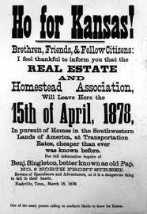
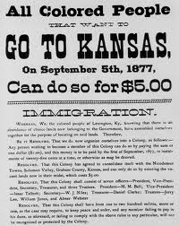
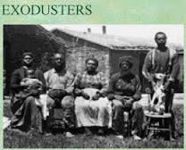
Exodusters
Exodus told a story of how people of ancient Israel left Egypt to escape slavery. Many African Americans felt like they were like the people of Israel.

Slide 10
Settlers face hardships
Settlers had different reasons for moving to the Great Plains, but once there they all shared similar hardships.
#1 reason for hardships was the harsh climate!
Winters-were long and bitterly cold, temperatures could sink as low as 40 degrees below zero
Spring-brought violent thunderstorms, heavy rains, floods, tornadoes and hailstones as big as baseballs.
Summers-were hot and dry and droughts were common (a long period with little or no rain). This extreme weather could destroy crops for many years because the plants didn’t receive water.

Slide 11
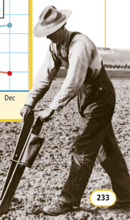
Hardships Continued
During dry weather, farmers had to watch out for prairie fires. Flames from campfire or lightning strikes could quickly spread across miles of prairie.
Settlers even had to worry about grasshoppers because they ate clothing, crops, and even wood handles from farm tools.
Some thought life on the Plains was too difficult and left and others stayed and adapted to the environment.

Slide 12
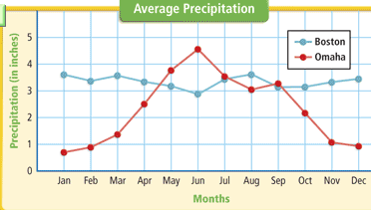
This graph shows the average precipitation in Omaha, Nebraska, and in Boston, Massachusetts.
Compare the precipitation in each city. Why would crops from Massachusetts not grow well on the Great Plains?

Slide 13
Settlers Adapt to the Great Plains
The first problem they faced was how to build a house. Wood was very scare on the Plains, so most made their houses out of sod. Sod is grass-covered dirt held together by thick mass of roots. Settlers cut pieces of sod from the prairie and used them like bricks. Sod kept houses cool in the summer and warm in the winter. Sod did leak though during storms. Also, animals dug through the sod.
Great Plains farmers became known as sodbusters: because they had to break through so much thick soil.

Slide 14
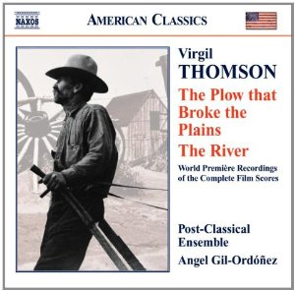
Music of the Great Plains
Virgil Thompson wrote a song
called “The Plow That Broke the
Plains”. He was born in Kansas in 1896
And wrote the music for the movie
In 1936.
What aspects of the Great Plains does the music suggest to you?

Slide 15
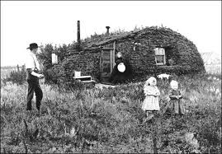
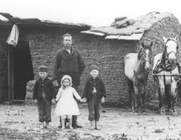
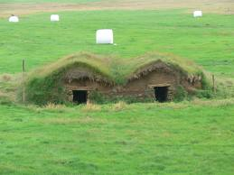
Sod House Building
*Click here to see sod houses

Slide 16
Growing Crops
Another challenge sodbusters faced was finding crops that would grow in a dry climate. They decided to grow a specific kind of wheat from Eastern Europe.
Because there was little rainfall, farmers carried water from streams or dug deep wells and pumped water. It was very difficult and expensive to get water. They used wind power to help operate their water pumps.
Farmers couldn’t hire extra workers because few people lived on the Plains, therefore they replaced workers with new farming machines.

Slide 17
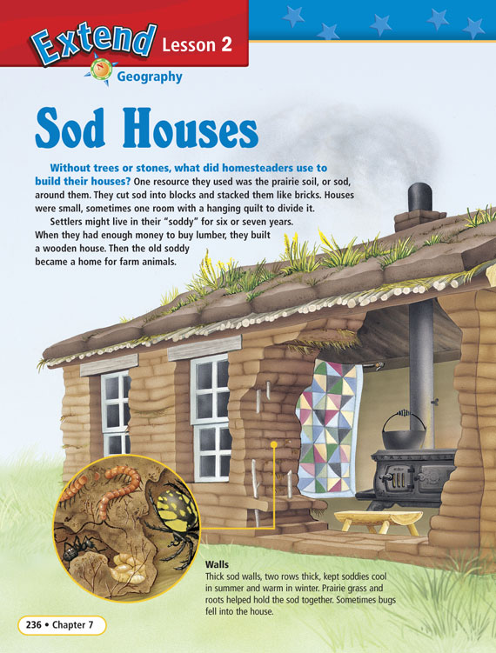
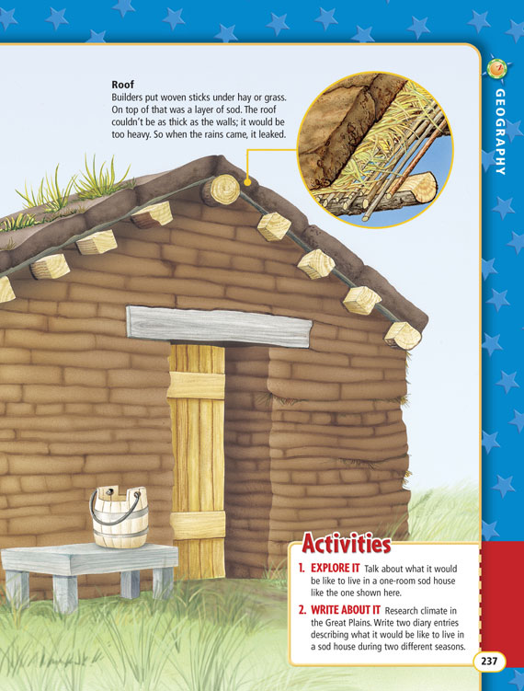
Sod Houses

Slide 18
“Dakota Dugout”
http://amhistory.si.edu/ourstory/pdf/sodhouse/sodhouse_readdakota.pdf
Complete the activity from the link above after reading the story.

Slide 19
Sod House Activity
http://amhistory.si.edu/ourstory/activities/sodhouse/more.html
Students will come outside and will measure out their sod houses using the worksheet for dimensions.
Activity: Ask students to create a building plan for their house. Plans may include diagrams, sketches, and written explanations of their house. Label the parts of your house. What materials would you use? Design a sketch of your frontier house.

Slide 20
Homestead Act Video
18 minutes long

