Slide 1
Chapter 9 Lesson 3 pages 312-315
EQ: How can you describe the effects of WWI on the home front? How did the Allied victory affect world events and attitudes?

Slide 2
Vocabulary
Rations: limits on consumption of food and goods
Propaganda: material distributed for the purpose of winning people over to a given doctrine
Armistice: an agreement between two armies to stop fighting
Isolationism: policy that a nation should avoid political and economic relationships with other countries

Slide 3
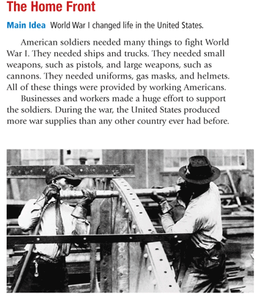

Slide 4
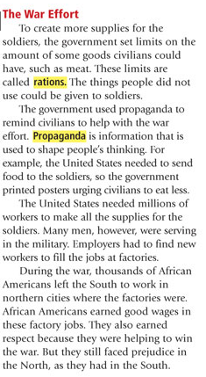
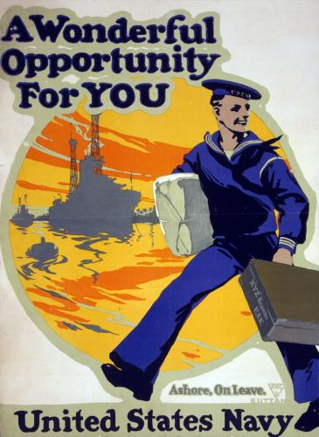
http://www.youtube.com/watch?v=ouNv9pluZxg

Slide 5
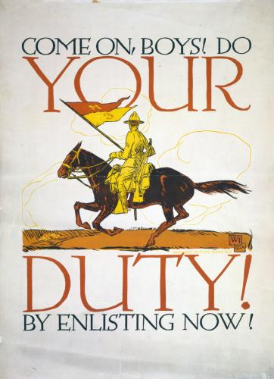
Come on, boys! Do your duty by enlisting now!
The United States Army was quite small in the spring of1917. A draft was quickly established, but men were urged to enlist for service. This poster, showing a cavalry charge, portrayed military service as heroic

Slide 6
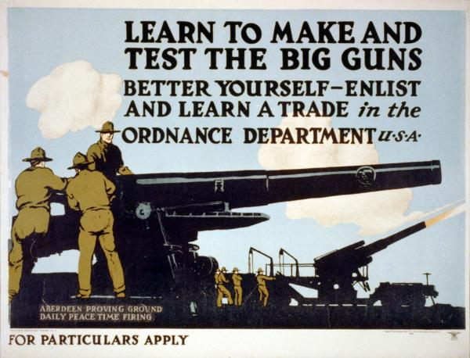
The army offered men a chance to learn skills that might serve them in a future job or “trade.” This recruitment strategy — still seen today in television commercials — was used for the first time in World War I.

Slide 7
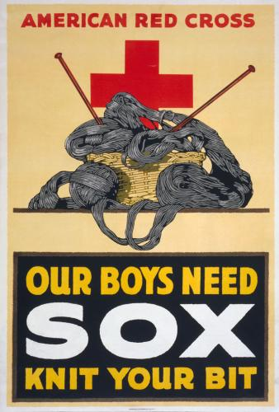
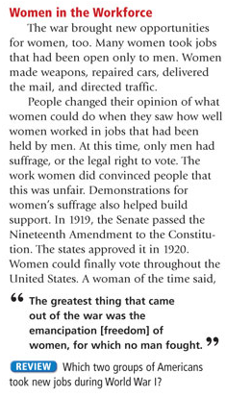
Women could not serve in the army, but they could help the war effort in other ways. This poster urged women to knit socks for soldiers, even though textile factories made soldiers’ uniforms. Efforts like these had more to do with generating feelings of patriotism than with actually supplying the troops.

Slide 8
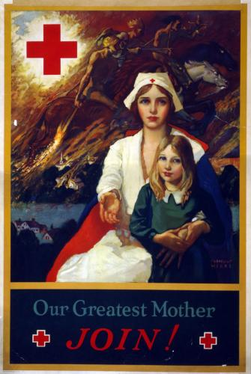
Women who wanted to play a more active role could serve as nurses. This poster showed nursing as the natural extension of motherhood. A Red Cross nurse, “our greatest mother,” shelters a young girl from the war raging in the background.

Slide 9
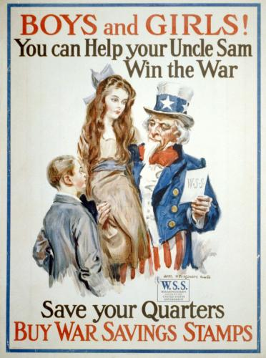
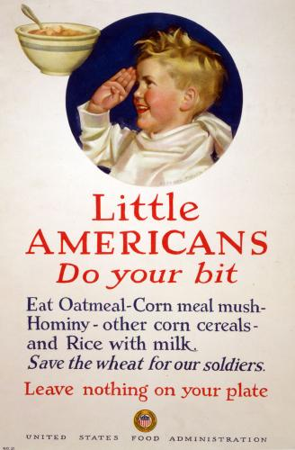
Children couldn’t afford liberty bonds, but to encourage them to support the war, the government sold war savings stamps worth 10 cents and 25 cents. Like war bonds, the stamps paid interest. In this poster, Uncle Sam teaches children a lesson not only about patriotism but about the importance of saving.
Even the smallest children were enlisted in the war effort. Wheat was needed for soldiers, and so children (and their mothers) were encouraged to eat other grains such as oatmeal, corn, and rice — and were reminded, like children everywhere, to clean their plates

Slide 10
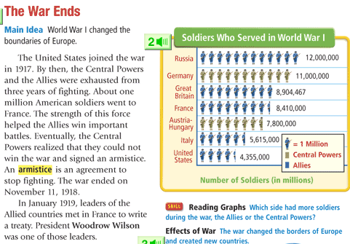

Slide 11
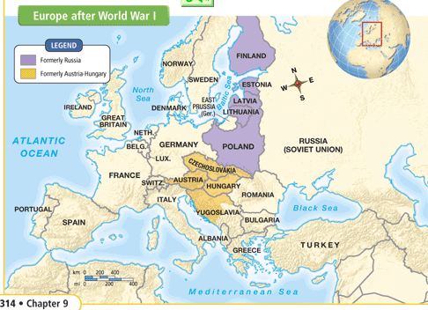

Slide 12
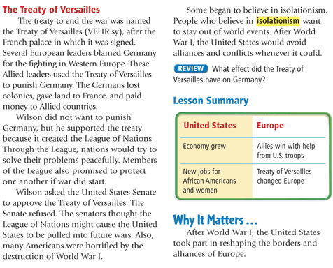

Slide 13
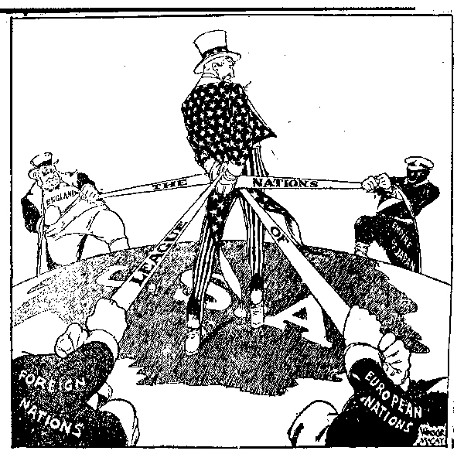
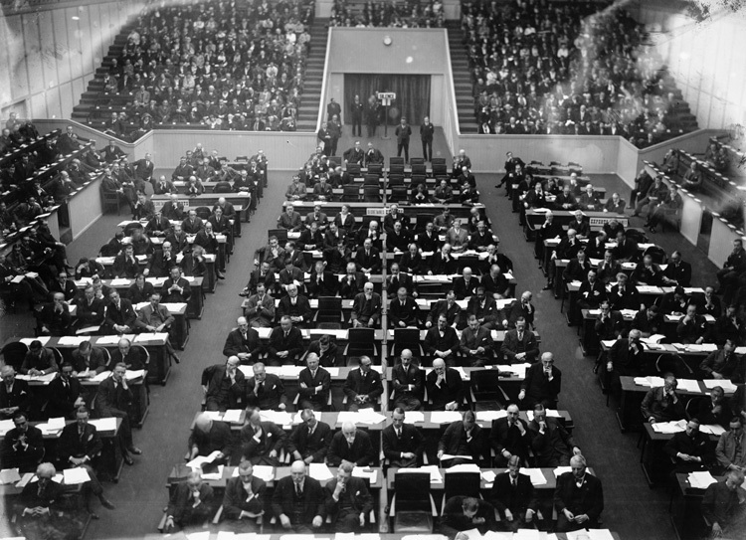
League of Nations

Slide 14
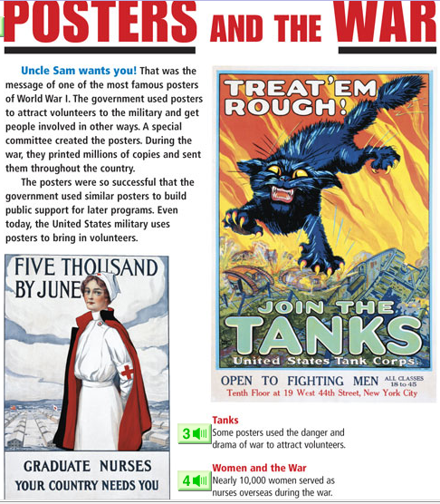

Slide 15
