Slide 1
Conflict on the Plains
Chapter 7, Lesson 4

Slide 2
Vocabulary
Reservation: land set aside for Native Americans
Habitat: the area where an animal usually lives
Extinct: no longer in existence
Assimilate: to take on the cultural and social traditions of a group

Slide 3
War on the Plains
Beginning in the 1840s more settlers moved west to search for land or gold. They built towns and dug mines.
They divided land where American Indians already lived into farms and ranches.
U.S. government built roads and railroads to help settlers move and they tried to convince Indians to sell land and move to reservations (land that the government set aside for American Indians).
The Indians did not want to live on reservations that were small and far from the land where they hunted.

Slide 4
War on the Plains
Government hoped they would move to reservations and become farmers.
Indians, such as the Lakota and Arapaho, did not want to farm.
They were nomads (moved from one place to another to find food and water). Rode horses to hunt bison (buffalo).
These bison provided them with food and clothing.
The Indians fought the soldiers that tried to force them to move.

Slide 5
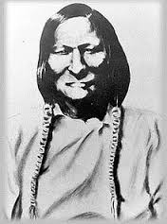
Sand Creek Massacre
1864, volunteer fighters of the Colorado militia attacked a Cheyenne village near Sand Creek, Colorado while they were asleep.
Chief Black Kettle raised a white flag to surrender, but the soldiers ignored him and killed almost half the people in the village.
Fighting increased after this massacre, but by the 1870s most Indian nations were forced to reservations.
Chief Black Kettle

Slide 6
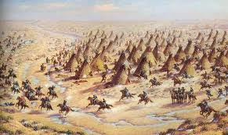
Sand Creek Massacre

Slide 7
Battle of the Little Bighorn
In the early 1870s George Custer led soldiers to the Black Hills (sacred/holy to Lakota) and found gold.
Thousands of Lakota and Cheyenne tried to protect the Black Hills from the soldiers.
In June of 1876, Custer and his troops tried to force Lakota onto a reservation.
They wouldn’t go so his troops attacked on the Little Bighorn River in Montana.
Led by Crazy Horse, Gall, and Sitting Bull the American Indians won the battle. All of the U.S. soldiers were killed.
The Nez Perce resisted being moved to Idaho. Chief Joseph was among those trying to lead them to Canada.
Several battles were fought before they surrendered in 1877.

Slide 8
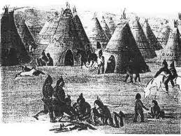
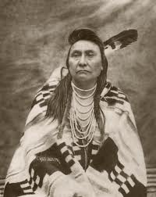
Battle of the Little Bighorn

Slide 9
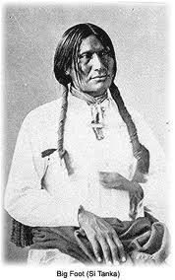
Wounded Knee
Many Indians began to follow a religion called the “Ghost Dance” which taught that the buffalo would return and dead Indians would come back to life.
Government worried the Ghost Dancers would start another war. (stop at 2 mins 45 secs)
When Sitting Bull became a Ghost Dancer, government sent police to arrest him. During the struggle he was killed.
This frightened the Ghost Dancers.
Led by Chief Big Foot many went to hide in the Badlands of South Dakota.
They were captured near Wounded Knee Creek on December 29, 1890. When the soldiers tried to take the Indians’ guns a fight broke out killing men, women, and children.

Slide 10
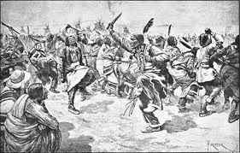
Wounded Knee

Slide 11
Destruction of the Buffalo
As more people moved to the great Plains wagon trails and railroad tracks cut across buffalo habitat (area where an animal or plant normally lives or grows).
Settlers killed buffalo for meat. Cattle carried diseases deadly to buffalo. Hunters shot buffalo for the skins to make coats or leather products.
Buffalo herds kept shrinking and soon were nearly extinct (no longer exists). By 1889 there were only about 1,000 buffalo left.

Slide 12
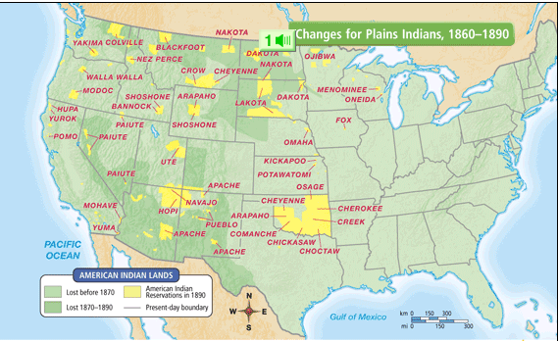
Changes for Plains 1860-1890

Slide 13
Government Policy
Reformers and lawmakers tried to make Indians change their culture and tradition to blend with American life (Assimilate).
They made the Ghost Dance illegal.
Children were sent to school where they could not speak American Indian languages or wear traditional clothing.
1887, Dawes Act took reservation land split it into smaller pieces. Some was given to American Indians to farm, the rest was sold to settlers.
The Indians did not know how to farm.
They became dependent on the federal government for food.

Slide 14
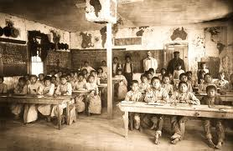
Indian Schools

Slide 15
