Slide 1
Inventions
EQ: What makes a good invention? How did inventions change the 19th century?
Pictures taken from: http://www.popsci.com/gadgets/article/2011-03/archive-gallery-popscis-daycare-horrors

Slide 2
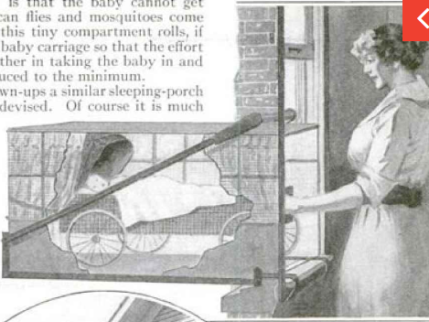
Sleeping Baby Porch
A baby porch suspended a hundred feet above ground? What could possibly go wrong? As city populations grew, people grew concerned about raising young children in tight spaces. Inventors suggested the miniature sleeping porch, which could be installed outside any window. The device seemed sturdy enough -- an iron brace enabled it to carry 500 pounds of weight.

Slide 3
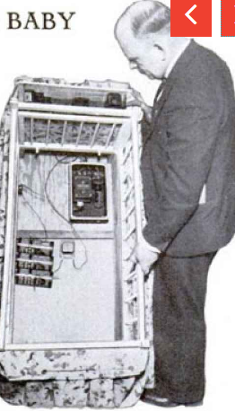
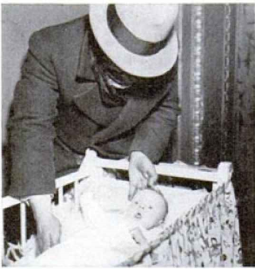
Black Light Guards Baby
Memories of the Lindbergh baby kidnapping were still fresh during the spring of 1934 -- hence the black light baby alarm. Think of it like the high-tech laser alarms you see in heist movies. Concealed behind a curtain, the black light would focus on an electric sensor that would trigger an alarm if the barrier were breached. While a kidnapping detector certainly sounds well-intentioned, it was only a matter of time before parents decided they were uncomfortable with all of that machinery hidden beneath their baby's mattress.

Slide 4
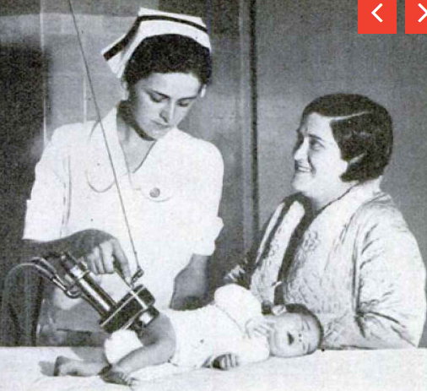
Ultra-violet lamp stencil
No one wants to go home with the wrong newborn, hence the invention of a ultraviolet branding tool that would burn a baby's initials into its skin to prevent hospital mix-ups. The hand-held lamp would pass ultraviolet rays through stenciled initials, leaving pale marks that would fade away after a couple of weeks. Nothing says heartwarming like baby's first sunburn.

Slide 5
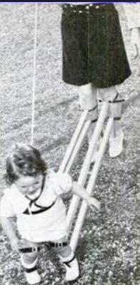
Baby Walker
Most parents teach their baby to walk by gently lifting them up by the arms, or by investing in a wheeled baby walker. One Swiss engineer, however, decided it'd be a better idea to strap wooden beams between his legs and those of his baby. That way, he could guide the baby's movements. Meanwhile, a harness attached to an overhead pulley would keep the child upright and balanced.

