Slide 1
Electricity and Magnetism
Chapter 4:
Standards: S5P3 Students will investigate electricity, magnetism, and their relationships

Slide 2
Lesson 1: What is Static Electricity?
Vocabulary Preview
Electric charge: basic property of the tiny particles that make up matter
Static Electricity: buildup of charges in one place
Electric Field: space in which the electric force acts

Slide 3
Two Kinds of charge
Energy is a word used to describe some kinds of energy. When you did the experiment with the balloons you produced one kind of electricity.
Rubbing the two balloons together caused a change. They either pulled toward each other or pushed away from each other.
These two results come from a single property of matter-electric change.

Slide 4
Electric Charge
An electric charge is a basic property of the tiny particles that make up matter.
Electric charges can be positive or negative.
Positive and Negative charges cancel each other out.
As a result, matter usually has a balance of two kinds of charge and this is called neutral.

Slide 5
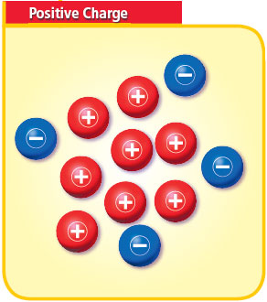
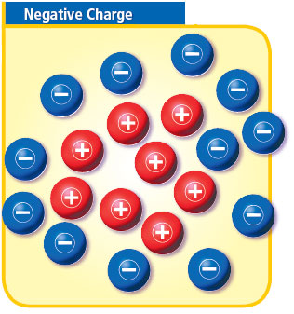
Positive and Negative Charges
A positive charge is labeled + . A negative charge is labeled -. When an object has more +s than -s, it has a + electric charge. When it has more -s than +s, it has a - electric charge.

Slide 6
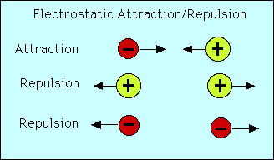
Positive and Negative Charges
When an object has more particles with a negative charge than particles with a positive charge, it is negatively charged.
Positive/Negative charges attract to one another. (pull toward each other)

Slide 7
Static Electricity
The buildup of charges in one place is called static electricity.
When clothes are taken out of a dryer, they crackle and stick together.
The rubbing of the clothes against each other in the dryer causes static electricity.

Slide 8
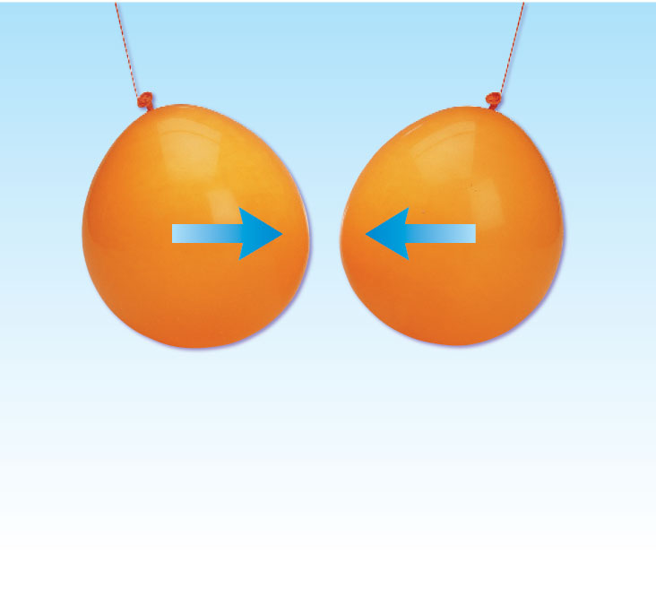
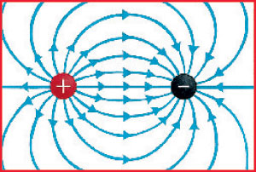
Electric Field
Both positive and negative charges have electric fields around them.
An electric field is the space in which an electric force acts .
The force gets weaken as you move further away from the charged object.
One balloon has a positive charge. The other one has a negative charge. Their electric fields form a closed pattern of lines. The balloons attract each other. Does the way the balloons react depend on which balloon is positive and which is negative?

Slide 9
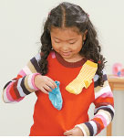
Wrap-up Questions
1. How can a plastic ruler get a positive charge?
By gaining negative charges
By losing negative charges
By gaining positive charges
By losing positive charges
Answer: B, by losing negative charges

Slide 10
2. Two charged objects attract each other. Which statement is true?
Neither is positive
Neither is negative
They have the same charge
They have opposite charges
Answer: D, they have opposite charges

Slide 11
Writing activity
Turn to page 185
You are going to do the writing activity.
Suppose you’re a balloon. Describe what happens to you as you gain a negative charge from a piece of wool. Write a narrative about this for a classmate.

