Slide 1

Unit 2: Rate, Ratio and Proportional Reasoning Using Equivalent Fractions

Slide 2

Standards: Understand ratio concepts and use ratio reasoning to solve problems.
MCC6.RP.1 Understand the concept of a ratio and use ratio language to describe a ratio relationship between two quantities.
MCC6.RP.3 Use ratio and rate reasoning to solve real-world and mathematical problems, e.g. by reasoning about tables of equivalent ratios, tape diagrams, double number line diagrams, or equations.

Slide 3
Essential Questions:
What kinds of problems can I solve by using ratios?
What information do I get when I compare two numbers using a ratio?
What are equivalent ratios? Can I give examples of equivalent ratios?
What is the difference between a multiplicative and an additive relationship?

Slide 4
Content Objective:
I can communicate relationships between two quantities using ratio notation and language.
Language Objective:
I can verbally explain to my group whether two ratios make a proportion using math vocabulary.

Slide 5
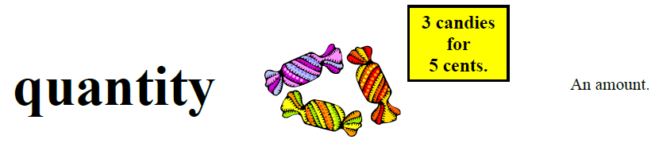
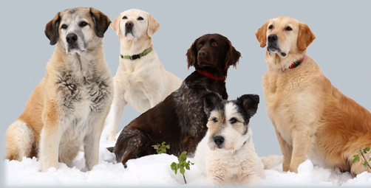
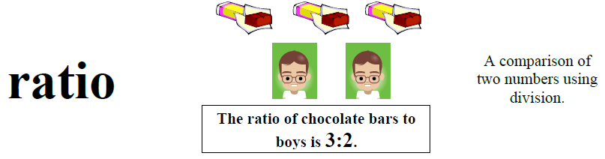
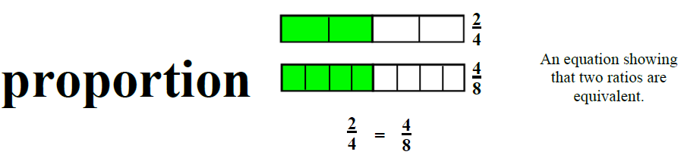
5 dogs
Quantity: is an amount that can be counted or measured.
Ratio: compares quantities that share a fixed, multiplicative relationship.
Unit Ratio: are ratios written as some number to 1.
LOTS: Language of the Standards

Slide 6
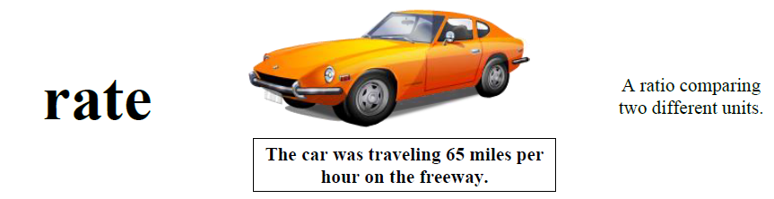
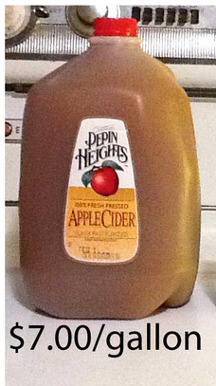
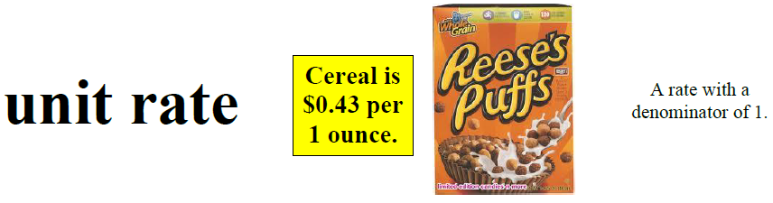
Rate: A comparison of two quantities that have different units of measure.

Slide 7
Describe relationships using ratio, for example:
Part to part: Compare the number of girls to
boys in the classroom using the different
symbols for ratio (girls: boys, girls to boys,
𝑔𝑖𝑟𝑙𝑠/𝑏𝑜𝑦𝑠). Then compare the number of boys
to girls in the same way.
Part to whole: Compare the number of girls to
the whole class. Do the same thing for the boys in the class.

Slide 8
Compare the number of girls to boys in the classroom.
Ratio: compares quantities that share a fixed, multiplicative relationship.

Slide 9
Now, compare the number of boys to girls in the same way.
Ratio: compares quantities that share a fixed, multiplicative relationship.

Slide 10
Compare the number of girls to the whole class.
Ratio: compares quantities that share a fixed, multiplicative relationship.

Slide 11
Do the same thing for the boys in the class.
Ratio: compares quantities that share a fixed, multiplicative relationship.

Slide 12
Directions:
  Name the ratio using math symbols.
  Identify the type of ratio.

Slide 13

1. Stars to moons.

Slide 14




2. Insects to grasshoppers.

Slide 15
3. Cones to scoops of ice cream.

Slide 16





4. Puppies to kittens.

Slide 17




5. Apples to pieces of fruit.

Slide 18
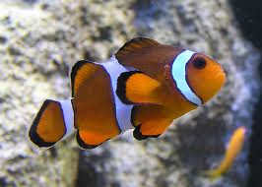
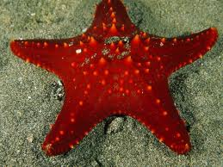
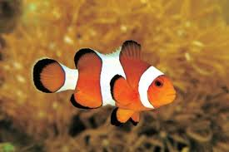
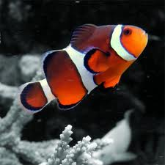
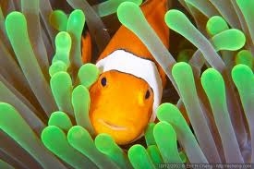
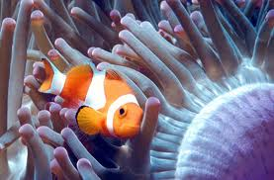
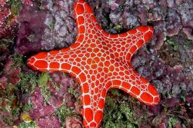

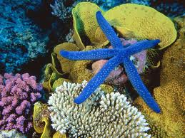
6. Clownfish to starfish.

Slide 19










7. Yellow cars to red cars.

Slide 20









8. Satellites to cell phones.

Slide 21

9. Sneakers to basketballs.

Slide 22

Pizzas to delivery people.

Slide 23
Wheels to bicycles.

Slide 24
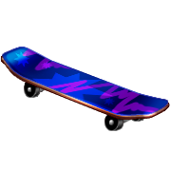


Skateboards to things with wheels.

Slide 25
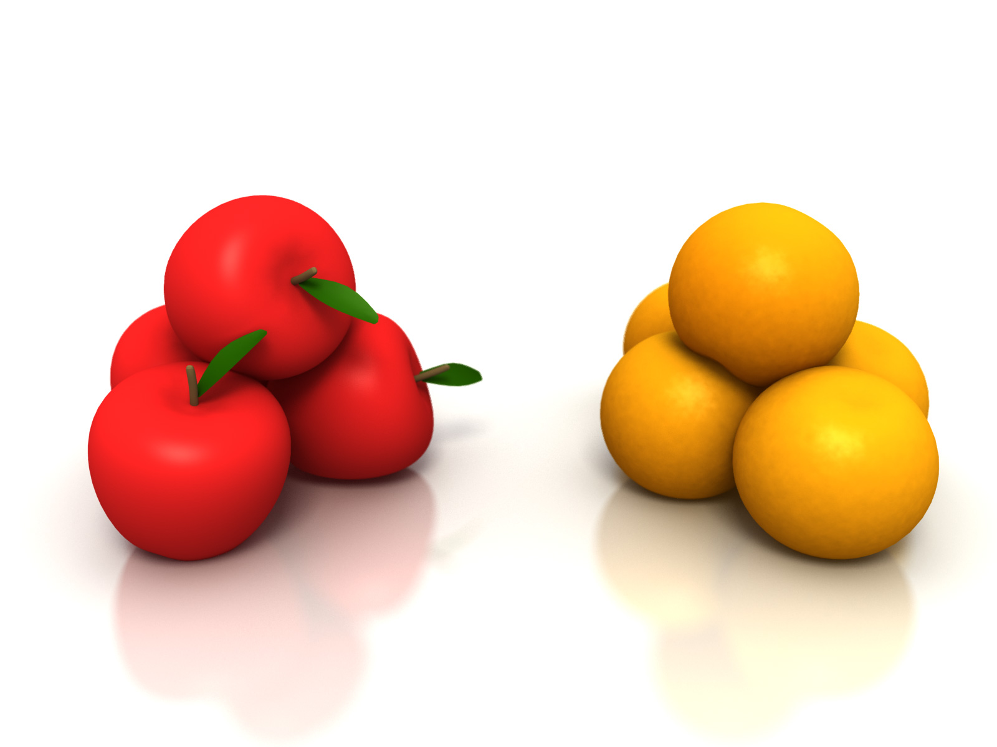
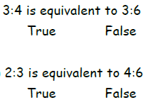
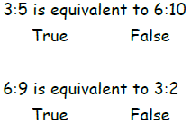
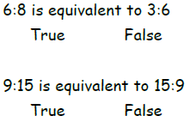
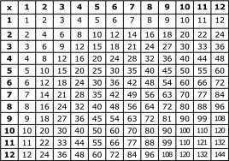
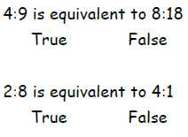
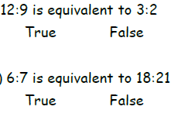
Click Here: Solve Missing Values in Ratio Problems Using a Table Video
Discuss with your group whether each statement is true or false. Be prepared to explain why!

Slide 26
http://learnzillion.com/lessons/586-solve-ratio-problems-using-tables-and-addition
To make yummy fruit punch, use 2 cups of grape juice for every 3 cups of apple juice.
If you already have 12 cups of apple juice, how many cups of grape juice will you need to make fruit punch?

Slide 27
In this lesson you will learn to solve ratio problems by using tables and addition.

Slide 28
Let’s Review
Ratios show how two (or more) quantities are related.
Part-to-Part Ratio
Part-to-Total Ratio
Notes:
28

Slide 29
Thinking that a ratio describes just one situation
Example: 2 eggs for every 3 cups of flour
Notes:
29

Slide 30
To make yummy fruit punch, use 2 cups of grape juice for every 3 cups of apple juice. If you already have 12 cups of apple juice, how many cups of grape juice will you need to make fruit punch?
To make yummy fruit punch, use 2 cups of grape juice for every 3 cups of apple juice. If you already have 12 cups of apple juice, how many cups of grape juice will you need to make fruit punch?
+2
+2
+2
Cups of grape juice
Cups of apple juice
Cups of grape juice | 2
Cups of apple juice | 3
Cups of grape juice | 2 | 4
Cups of apple juice | 3 | 6
Cups of grape juice | 2 | 4 | 6 | 8
Cups of apple juice | 3 | 6 | 9 | 12
+3
+3
+3

Slide 31
In this lesson you have learned to solve ratio problems by using tables and addition.

Slide 32
At the grocery store, you can buy 3 boxes of cereal for $8. How much would it cost to buy 24 boxes?

Slide 33
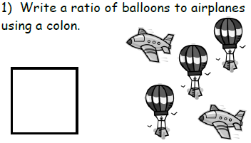
Think Fast…

Slide 34
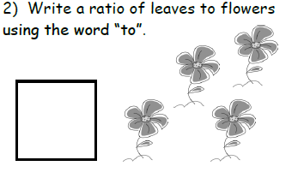
Think Fast…

Slide 35
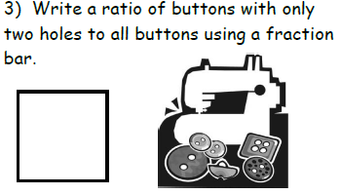
Think Fast…

Slide 36
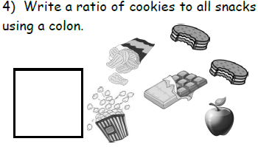
Think Fast…

Slide 37
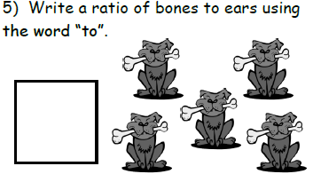
Think Fast…

Slide 38
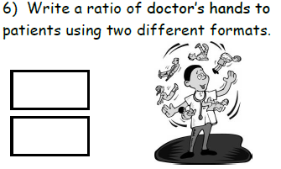
Think Fast…

Slide 39
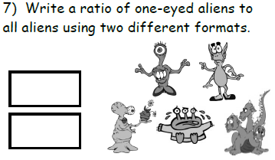
Think Fast…

Slide 40
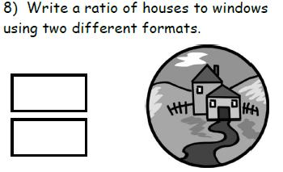
Think Fast…

Slide 41
http://learnzillion.com/lessons/587-solve-ratio-problems-using-tables-and-multiplication
To make yummy fruit punch, use 2 cups of grape juice for every 3 cups of apple juice.
If you already have 12 cups of apple juice, how many cups of grape juice will you need to make fruit punch?

Slide 42
In this lesson you will learn to solve ratio problems by using tables and multiplication.

Slide 43
Let’s Review
You can use addition to fill out a ratio table.
Example: 2 cups of grape juice for every 3 cups of apple juice
+2
+2
+2
Cups of grape juice | 2 | 4 | 6 | 8
Cups of apple juice | 3 | 6 | 9 | 12
+3
+3
+3
Notes:
43

Slide 44
Adding the same number to both rows
+9
Cups of grape juice | 2
Cups of apple juice | 3
Cups of grape juice | 2
Cups of apple juice | 3 | 12
Cups of grape juice | 2 | 11
Cups of apple juice | 3 | 12
+9

Slide 45
x4
x3
x2
Cups of grape juice | 2 | 4 | 6 | 8
Cups of apple juice | 3 | 6 | 9 | 12
x2
x3
x4

Slide 46
To make yummy fruit punch, use 2 cups of grape juice for every 3 cups of apple juice. If you already have 12 cups of apple juice, how many cups of grape juice will you need to make fruit punch?
x4
Cups of grape juice
Cups of apple juice
Cups of grape juice | 2
Cups of apple juice | 3
Cups of grape juice | 2
Cups of apple juice | 3 | 12
Cups of grape juice | 2 | 8
Cups of apple juice | 3 | 12
x4
Notes:
46

Slide 47
Cups of grape juice | 2 | 4 | 6 | 8
Cups of apple juice | 3 | 6 | 9 | 12
x1.5
x1.5
x1.5
x1.5
Notes:
47

Slide 48
To make yummy fruit punch, use 2 cups of grape juice for every 3 cups of apple juice. If you already have 12 cups of apple juice, how many cups of grape juice will you need to make fruit punch?
Cups of grape juice
Cups of apple juice
Cups of grape juice | 2
Cups of apple juice | 3
Cups of grape juice | 2
Cups of apple juice | 3 | 12
Cups of grape juice | 2 | 8
Cups of apple juice | 3 | 12
x1.5
x1.5
x1.5
x1.5
Notes:
48

Slide 49
In this lesson you have learned to solve ratio problems by using tables and multiplication.

Slide 50
To make purple paint, mix 3 gallons of blue paint for every 4 gallons of red paint. How much red paint will you need if you use 24 gallons of blue paint? Use a table with multiplication to solve.

Slide 51
Did I meet today’s objectives?
Content Objective:
I can communicate relationships between two quantities using ratio notation and language.
Language Objective:
I can verbally explain to my group whether two ratios make a proportion using math vocabulary.

Slide 52
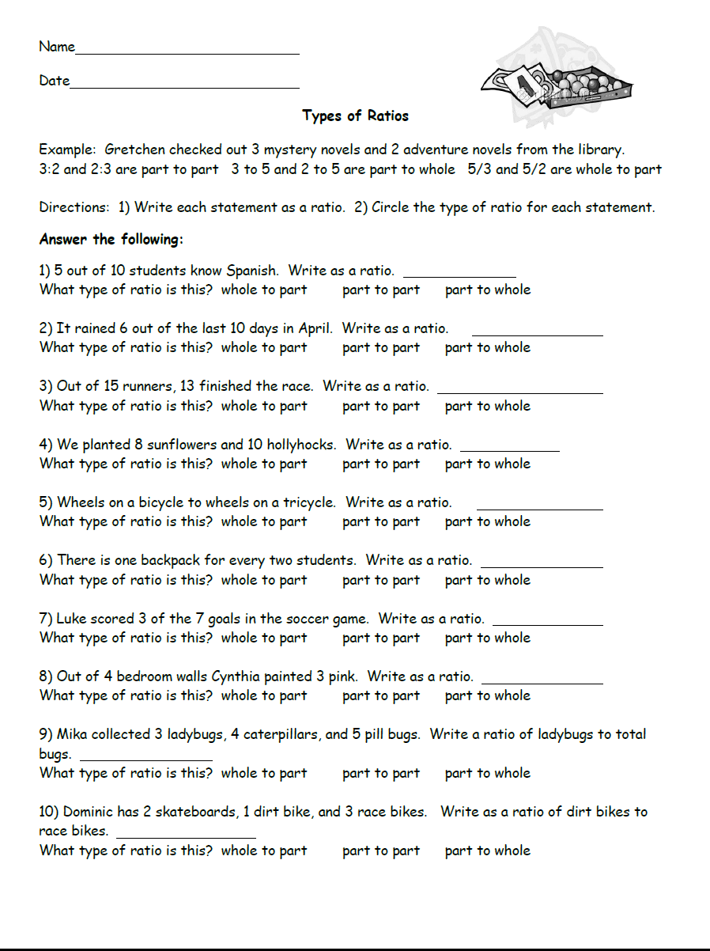
Click Here: Ratio Game
Need more practice???
Click Here: Thinking Blocks (Ratio Practice)

Slide 53
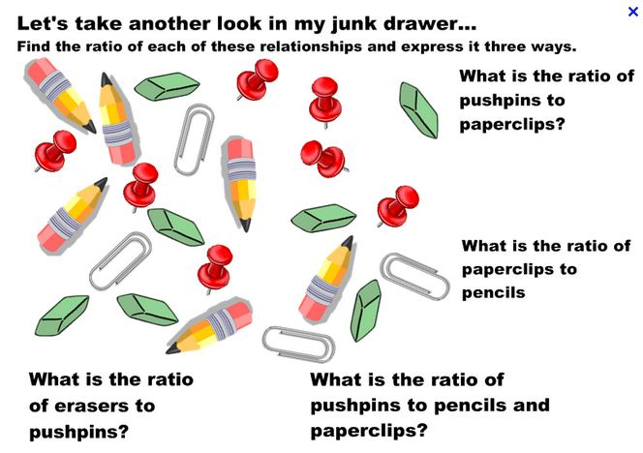
Formative
Ratios
4)
3)
?
1)
2)
5) Fill in the equivalent ratios.
5 : 8 = 10 : __ = __ :24 = 20 : __ = __ :40 = __ :48

Slide 54
Ticket Out the Door…
1. There are four dogs and three cats. What is the ratio of dogs to cats and cats to dogs?
2. The newspaper reported, “For every vote candidate A received, candidate B received three votes.” Describe possible election results using at least three different ratios. Explain your answer.

