Slide 1
Reconstruction Chapter 6 Lesson 1
Pages: 196-201
EQ: How did location influence the development of industry in the United States during Reconstruction?
How did Reconstruction change the lives of African Americans in the South?

Slide 2
Vocabulary Preview
Reconstruction: the period when the South rejoined the Union
Assassination: the murder of a public figure by surprise attack, usually for political reasons
Freedman’s Bureau: federal agency formed to aid and protect former slaves in the South after Civil War
Impeach: to formally charge a public official with misconduct in office

Slide 3
Plans for Reconstruction
Once the Civil War ended, Americans faced a challenge because they were split apart.
The period known as Reconstruction: was when we worked to bring the South back to the Union.
Americans couldn’t agree on how to do this. Some wanted to punish the South and others wanted to make it easy for them.

Slide 4
Lincoln
He didn’t want to punish the South, instead he wanted to make it easy on them.
He wanted to let southern states set up new governments and rejoin quickly.
Unfortunately, he didn’t get to make the final decision with Congress because on the evening of April 14, 1865 he was assassinated by John Wilkes Booth (an actor who supported the confederacy).

Slide 5
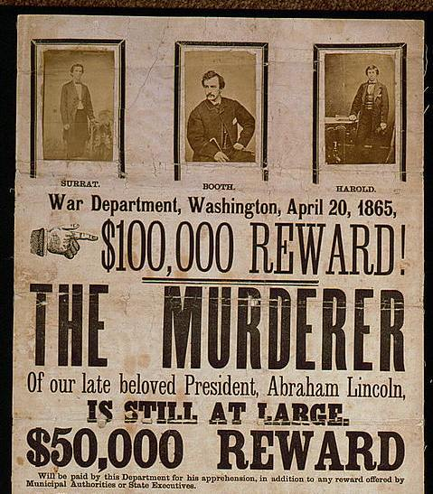
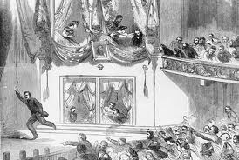

Slide 6
John Wilkes Booth

Slide 7
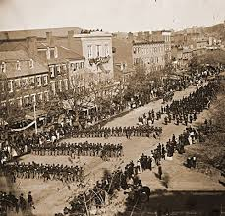
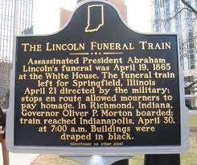
Funeral Train
Large crowds gathered for parades honoring President Lincoln after his death.

Slide 8
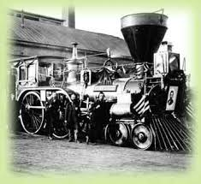
Funeral Train

Slide 9
Effects of the War
Thousands of people died during the Civil War and it changed both regions.
The South was destroyed: farms, cities, and factories were ruined. People had to rebuild everything.
The war brought freedom to enslaved people, but most had to homes or jobs. Southerners needed to find new ways to make their economies work.
The North grew stronger because their was little fighting their. Railroads and industries grew quickly after the war.

Slide 10
Table Talk
What made Reconstruction a challenge for Americans?
How was President Lincoln killed?
What effect did the war have on the South?

Slide 11
Andrew Johnson
He became president after Lincoln’s death. He put Lincoln’s plan into action in 1865.
Southern states quickly set up their new state governments and the federal government abolish slavery.
However, most southern states passed harsh laws called “Black Codes”. These limited the rights of former slaves to travel, vote, and work in jobs.

Slide 12
Andrew Johnson
Radical Republicans in Congress were unhappy about Black Codes. Johnson upset them more by allowing southern states to elect former Confederate leaders to Congress. They passed a law to protect the rights of freedman, who were people freed from slavery. Congress created the Freedman’s Bureau.

Slide 13
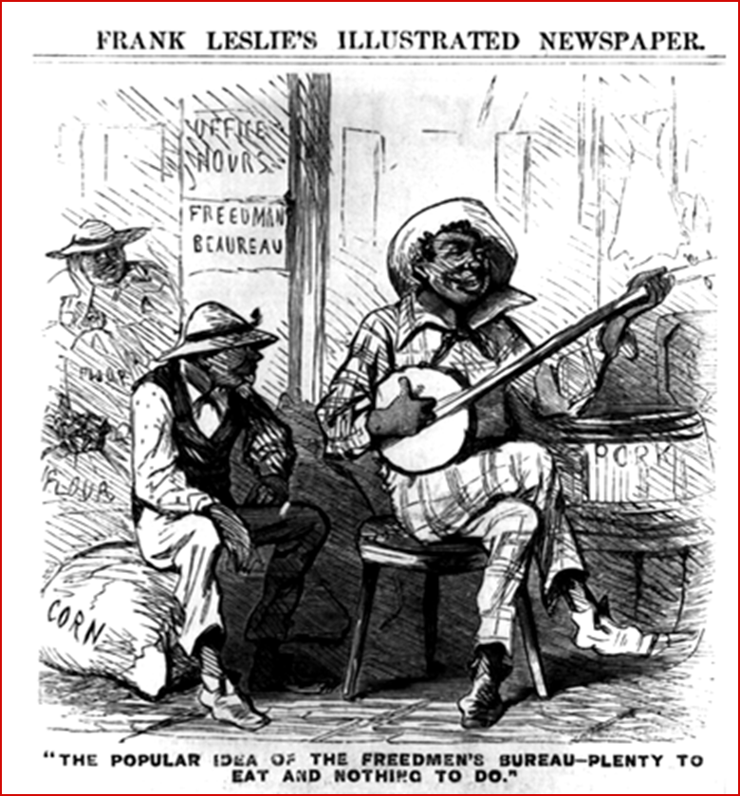
Freedman’s Bureau
It provided food, clothing, medial care, and legal advice to the poor. It set up hospitals and schools and found jobs for many.
Freedmen’s Bureau Seen Through Southern Eyes
“Plenty to eat and nothing to do.”

Slide 14
Congress Takes Control
1867: Congress (Radical Republicans) begins Reconstruction Plan. It put the South under military control. Soldiers from the national army marched into their land and forced southerners to obey Congress.
The states had to allow all men to vote (even blacks).
Congress tried to remove Johnson and they voted to impeach him (charge him with a crime). They accused him of breaking one of the new laws and they almost impeached him, but failed.

Slide 15
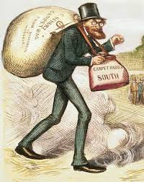
Scalawags
Some Southerners supported the Republicans during Reconstruction.
Those Southerners were unpopular in the South.
Southerners who helped the government during Reconstruction were known as scalawags. It was a slang word for “worthless horse”.

Slide 16
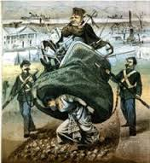
Carpetbaggers
Many northerners traveled south during Reconstruction. Some wanted to help rebuild the South, but others wanted to make money. These people were known as carpetbaggers, because they often carried suitcases made of carpet materials. Southerners disliked them and didn’t want them there.

Slide 17
Constitution Changes
During Reconstruction, Congress created three new amendments to the Constitution.
The amendments have the national government more power over the states. They also protected the rights of African Americans.

Slide 18
Amendments
This ended slavery in the US.
The states couldn’t limit the rights of citizens. They can’t take away life, liberty, or property without process of law.
This gave all men the right to vote, not matter their skin color.

Slide 19
Struggle for Rights Continues
The Amendments passed during Reconstruction helped all Americans. They protected peoples’ rights and made laws fairer.
The Amendments however, did not solve all the nation’s problems. Some people, both in the North and the South didn’t want African Americans to vote or have equal rights. Sometimes these laws were ignored and the struggle for equality would continue.

