Slide 1
Time of Reform
Chapter 8 Lesson 4

Slide 2
The Progressives
Jobs in factories were not always safe
People could slip on dirty floors
Machines were unsafe
Factories dumped dirt and poisons into city water
Smokestacks blew soot and smoke into city air
People got sick from the dirty water and air

Slide 3
The Progressives
Progressives wanted to make cities and factories cleaner and safer.
Progressives were reformers.
They thought government should make laws to protect workers, consumers, and citizens’ rights.

Slide 4
Making Changes
Progressives wrote about accidents and took pictures of children working in unsafe places
Convinced state lawmakers to protect workers and keep children from working
Progressives who wrote about the need for change were called muckrakers.
Muckraker is someone who “rakes up,” or points out, unpleasant truths

Slide 5
Making Changes
Upton Sinclair wrote a book called The Jungle
This book wrote about unsafe and dirty conditions in meatpacking plants.
It told about the use of chemicals to cover the taste of rotten meat

Slide 6
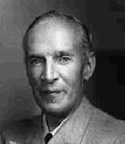

Slide 7
Government Reforms
President Theodore Roosevelt worked with congress to pass two laws in 1906 to make food safer
The Pure Food and Drug Act
The Meat Inspection Act
Stated that medicine and foods had to be made without harmful chemicals and the factories they were made in had to be clean

Slide 8
Government Reform
Roosevelt also wanted to preserve wilderness areas
Influenced by John Muir who believed that natural areas were precious resources
They visited Yosemite together
Roosevelt set aside millions of acres for national parks and wilderness areas

Slide 9
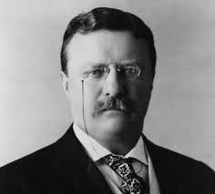
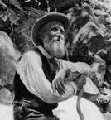

Slide 10
Working for Equal Rights
Women and African Americans could not vote in many states
They still faced discrimination in getting jobs and education

Slide 11
Voting Rights for Women
Women first called for the right to vote before the Civil War
In 1878, Congress voted against such an amendment
Carrie Chapman Catt and other women’s suffrage leaders gave speeches and wrote letters to lawmakers
Thousands of women protested in New York, Chicago, and Washington, D.C.

Slide 12
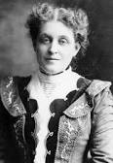

Slide 13
Voting Rights for Women
The 19th amendment guaranteed women the right to vote
In 1920, ¾ of the states approved the amendment and it became a law

Slide 14
Struggle for Racial Equality
African Americans, Mexican Americans, American Indians, and Asian Americans faced prejudice
Some states had laws that kept them from voting or that forced their children to go to separate schools
The National Association for the Advancement of Colored People (NAACP) was founded in 1909 to work for equality for African Americans (called “colored people” at the time)

Slide 15
Struggle for Racial Equality
One of the NAACP’s leaders was W.E.B. Du Bois.
Writer and professor
His writing persuaded many Americans that change was needed

Slide 16
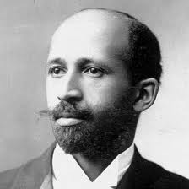

Slide 17
Struggle for Racial Equality
Booker T. Washington was another African American leader
He started a school to educate and give job training to southern African Americans

Slide 18
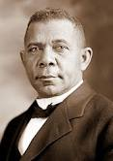

Slide 19
Struggle for Racial Equality
Around 1910, a growing number of African Americans left the south for jobs in northern cities
The Ku Klux Klan grew larger and the violence increased making life more difficult for southern African Americans
About 1.5 million African Americans moved north to work
This move was known as the Great Migration

